Slide 1


Computer Applications to Behavioral Sciences
Lecture 5. Loops & Iterations
何吉波，博士
清华大学用户体验学科负责人
优视眼动科技公司创始人
http://www.usee.tech

Slide 2
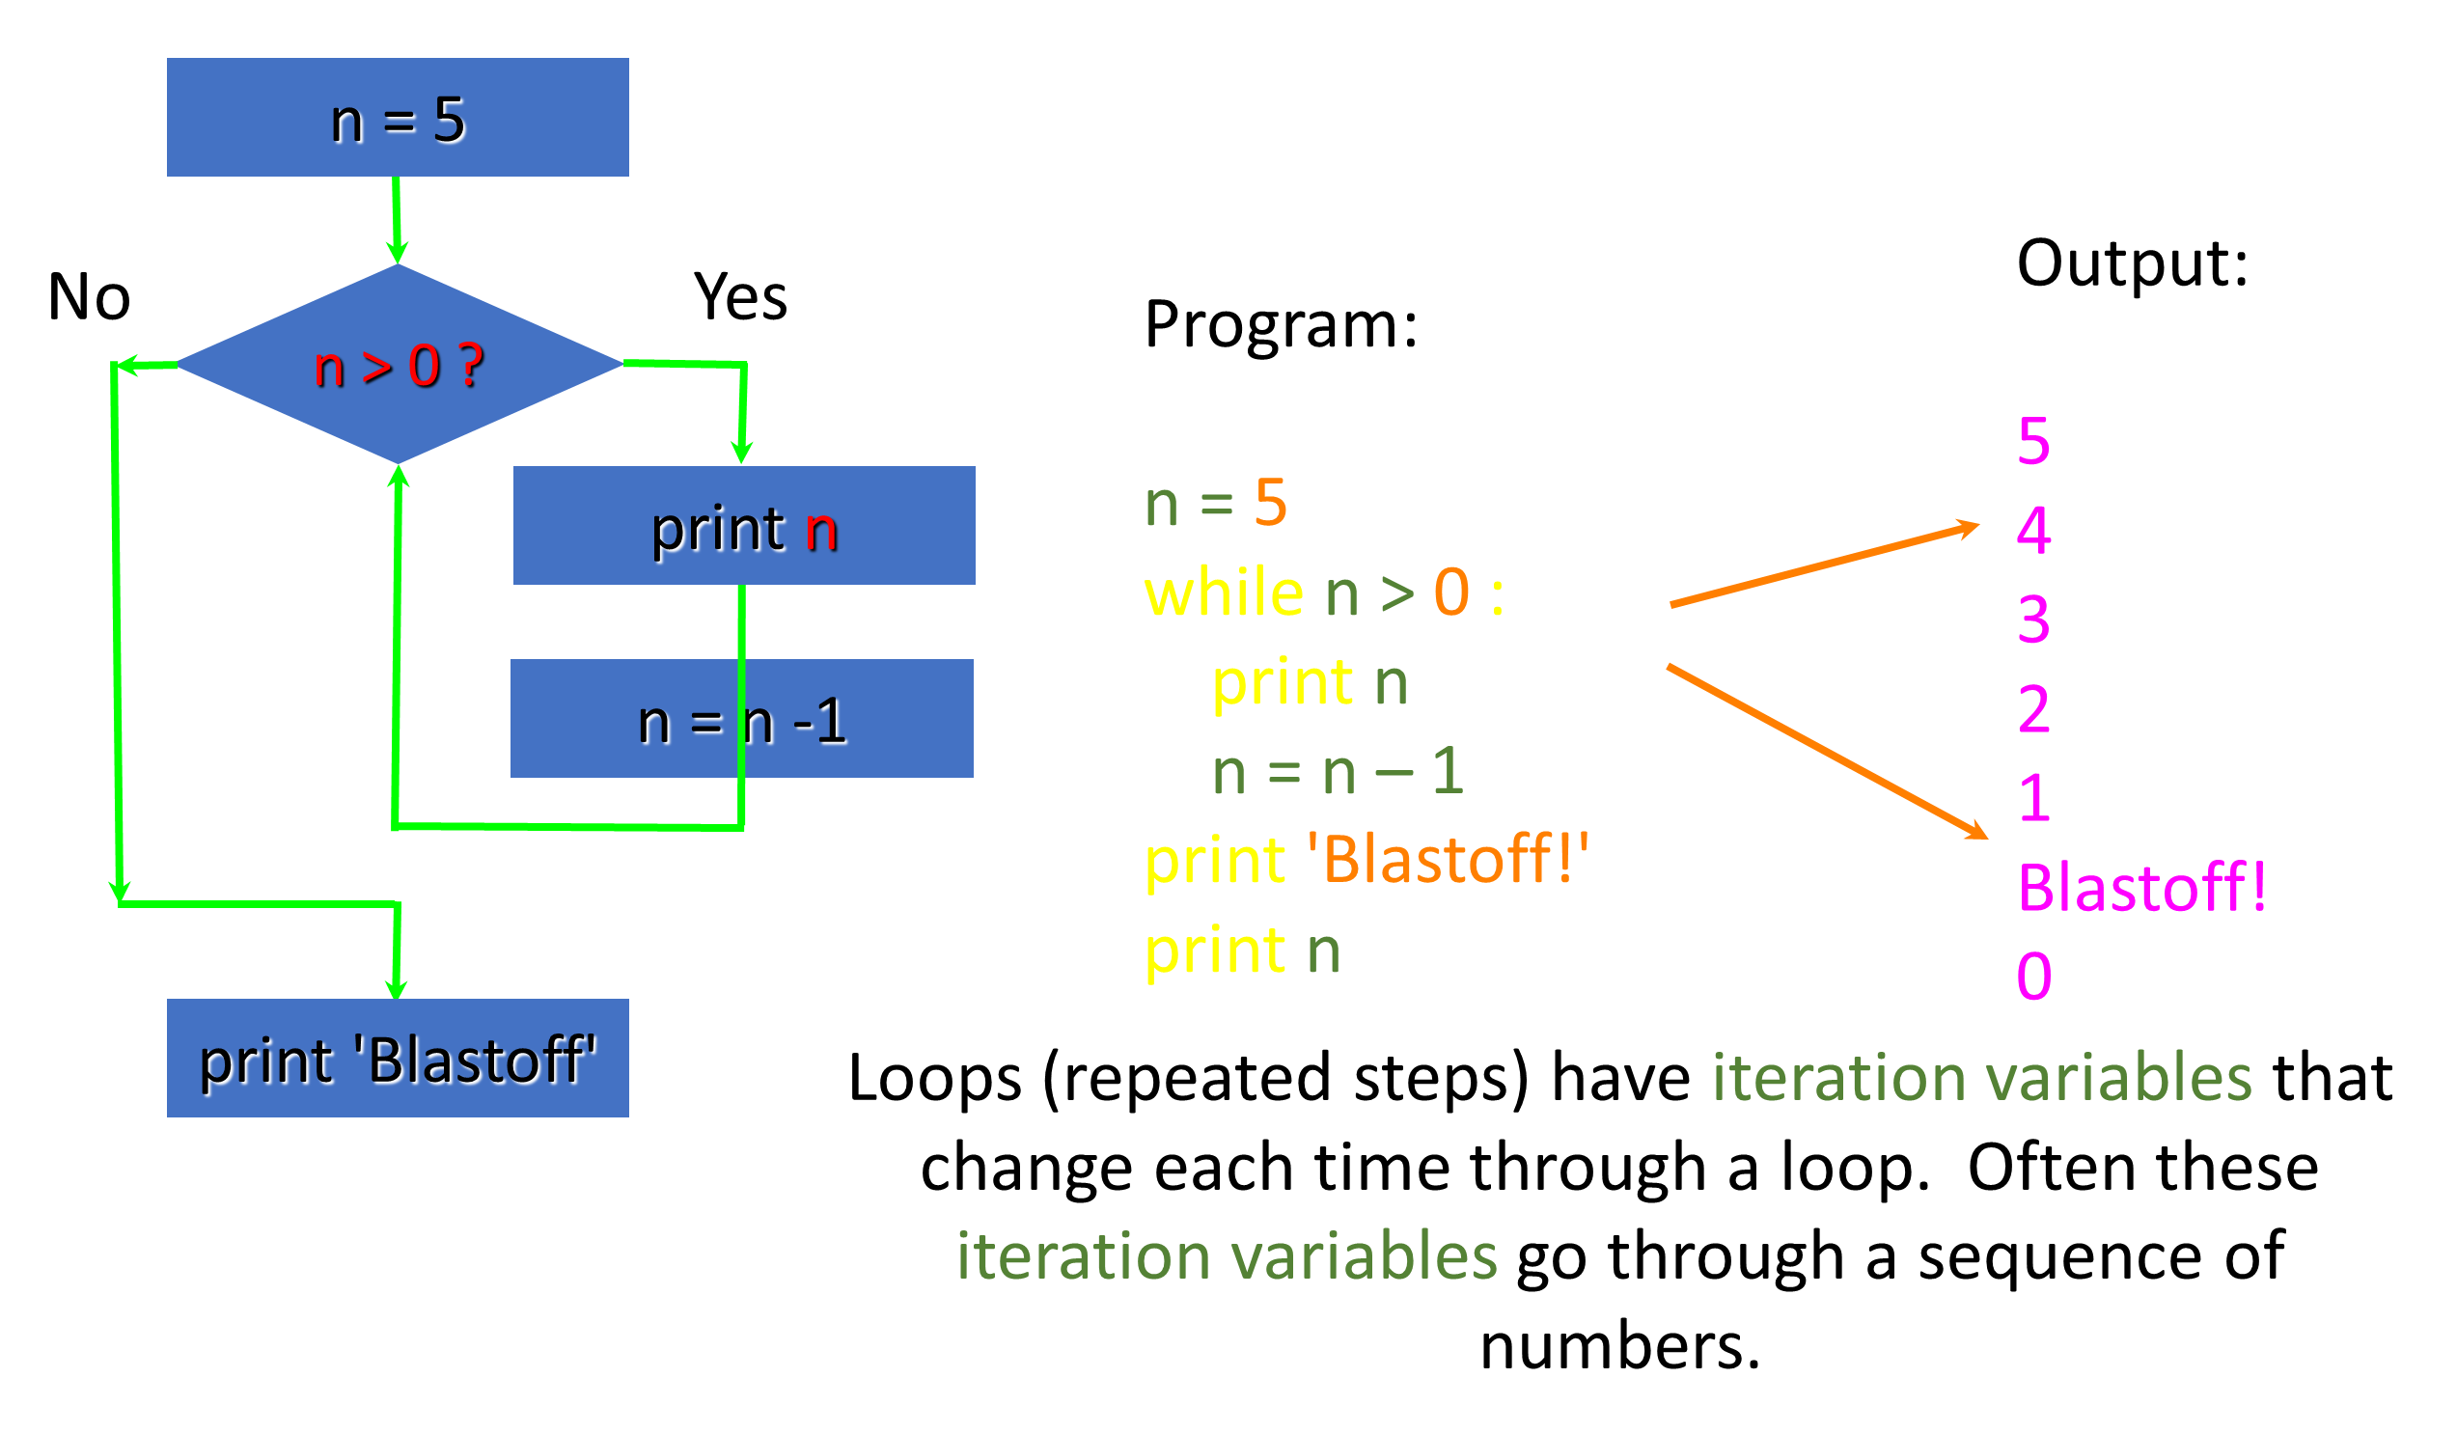

Slide 3
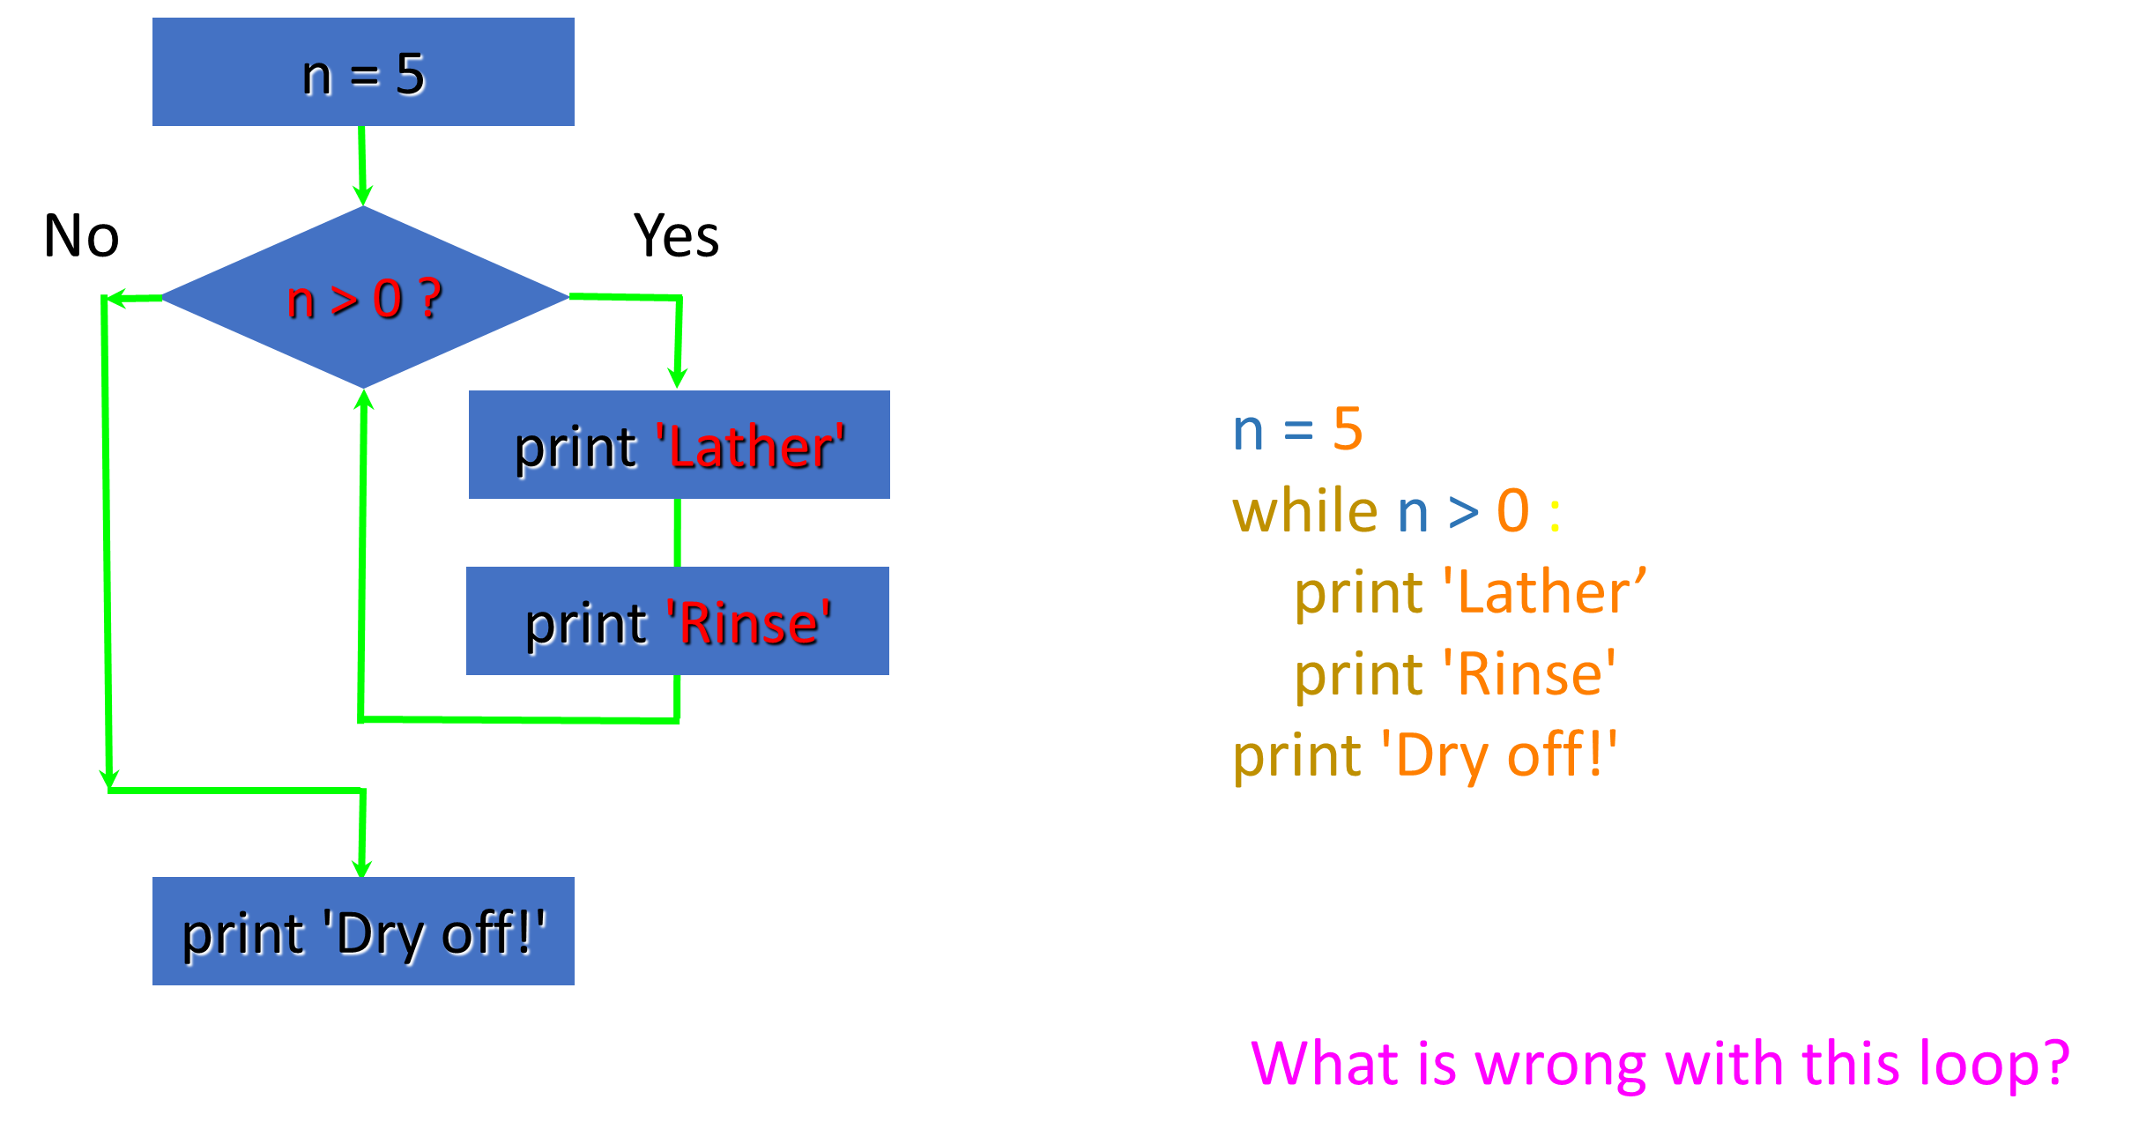
An Infinite Loop

Slide 4
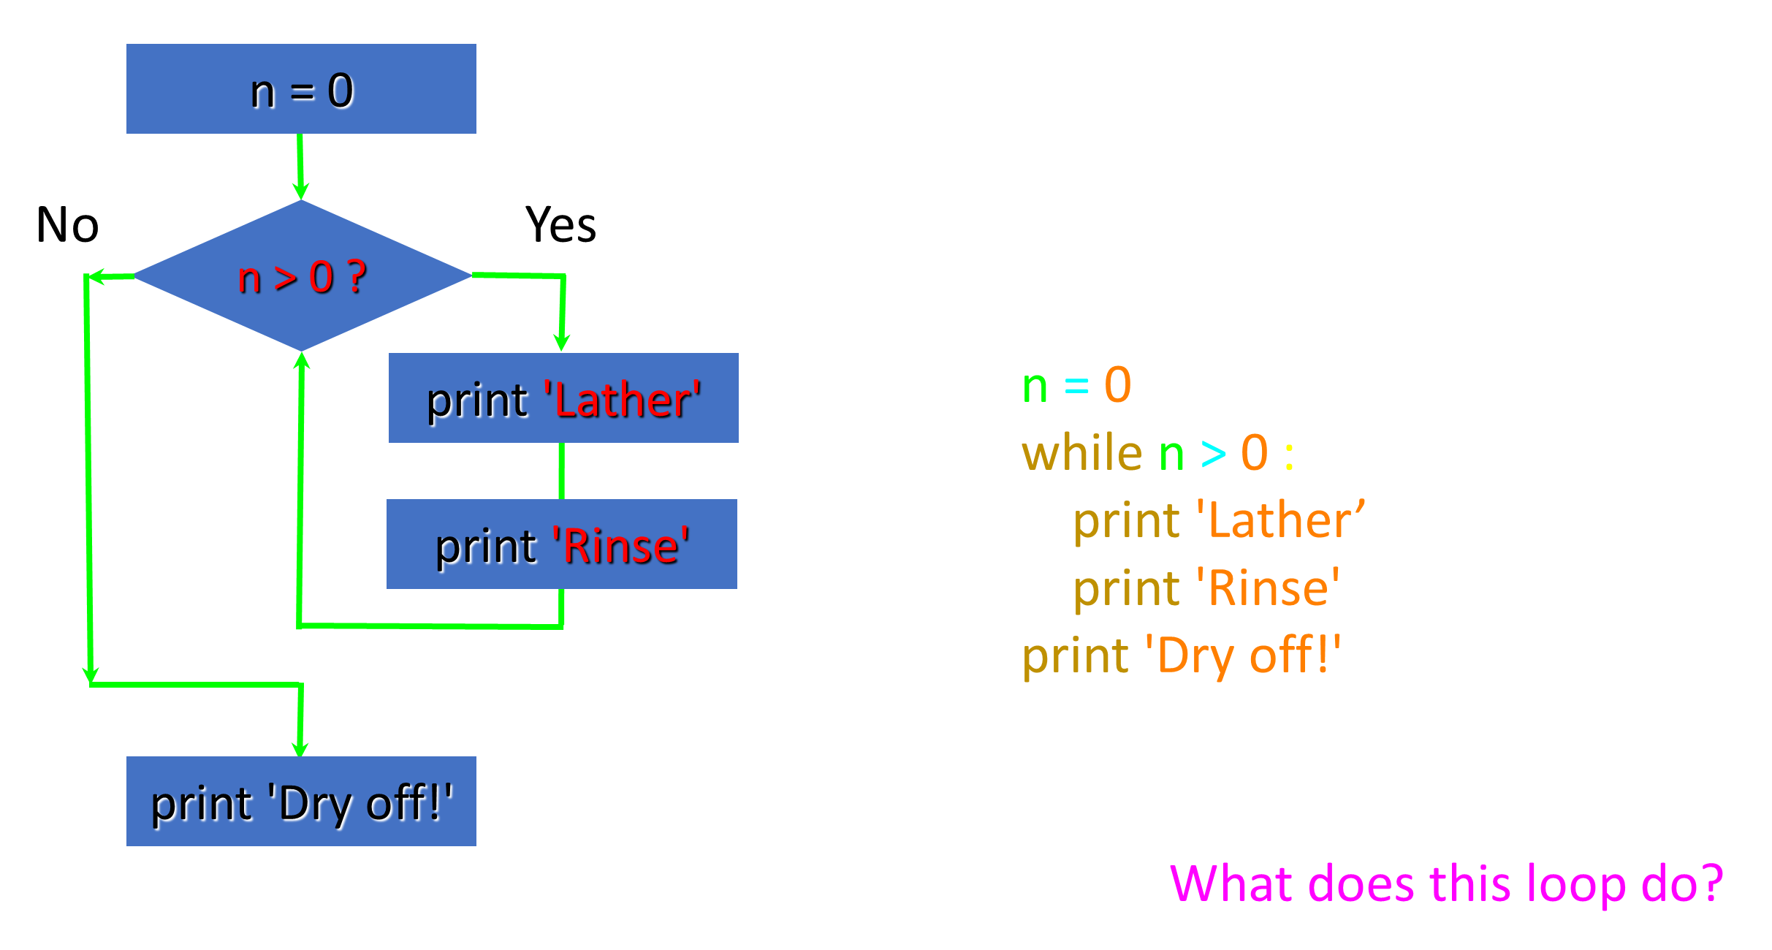
Another Loop

Slide 5
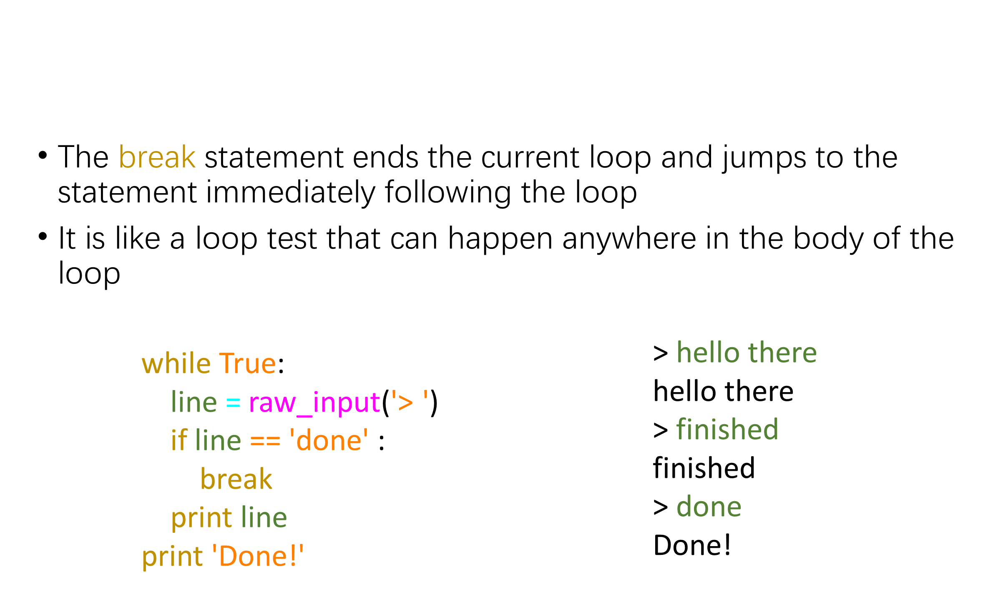
Breaking Out of a Loop

Slide 6
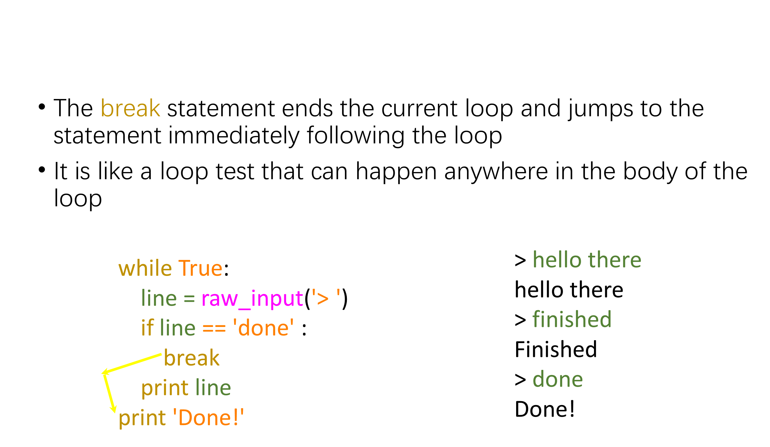
Breaking Out of a Loop

Slide 7
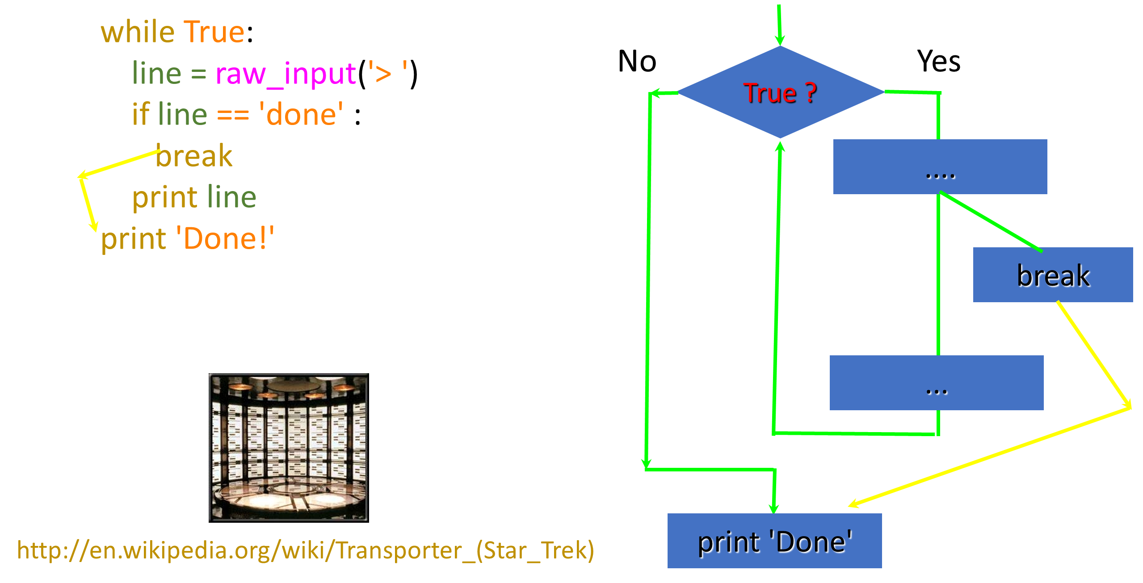

Slide 8
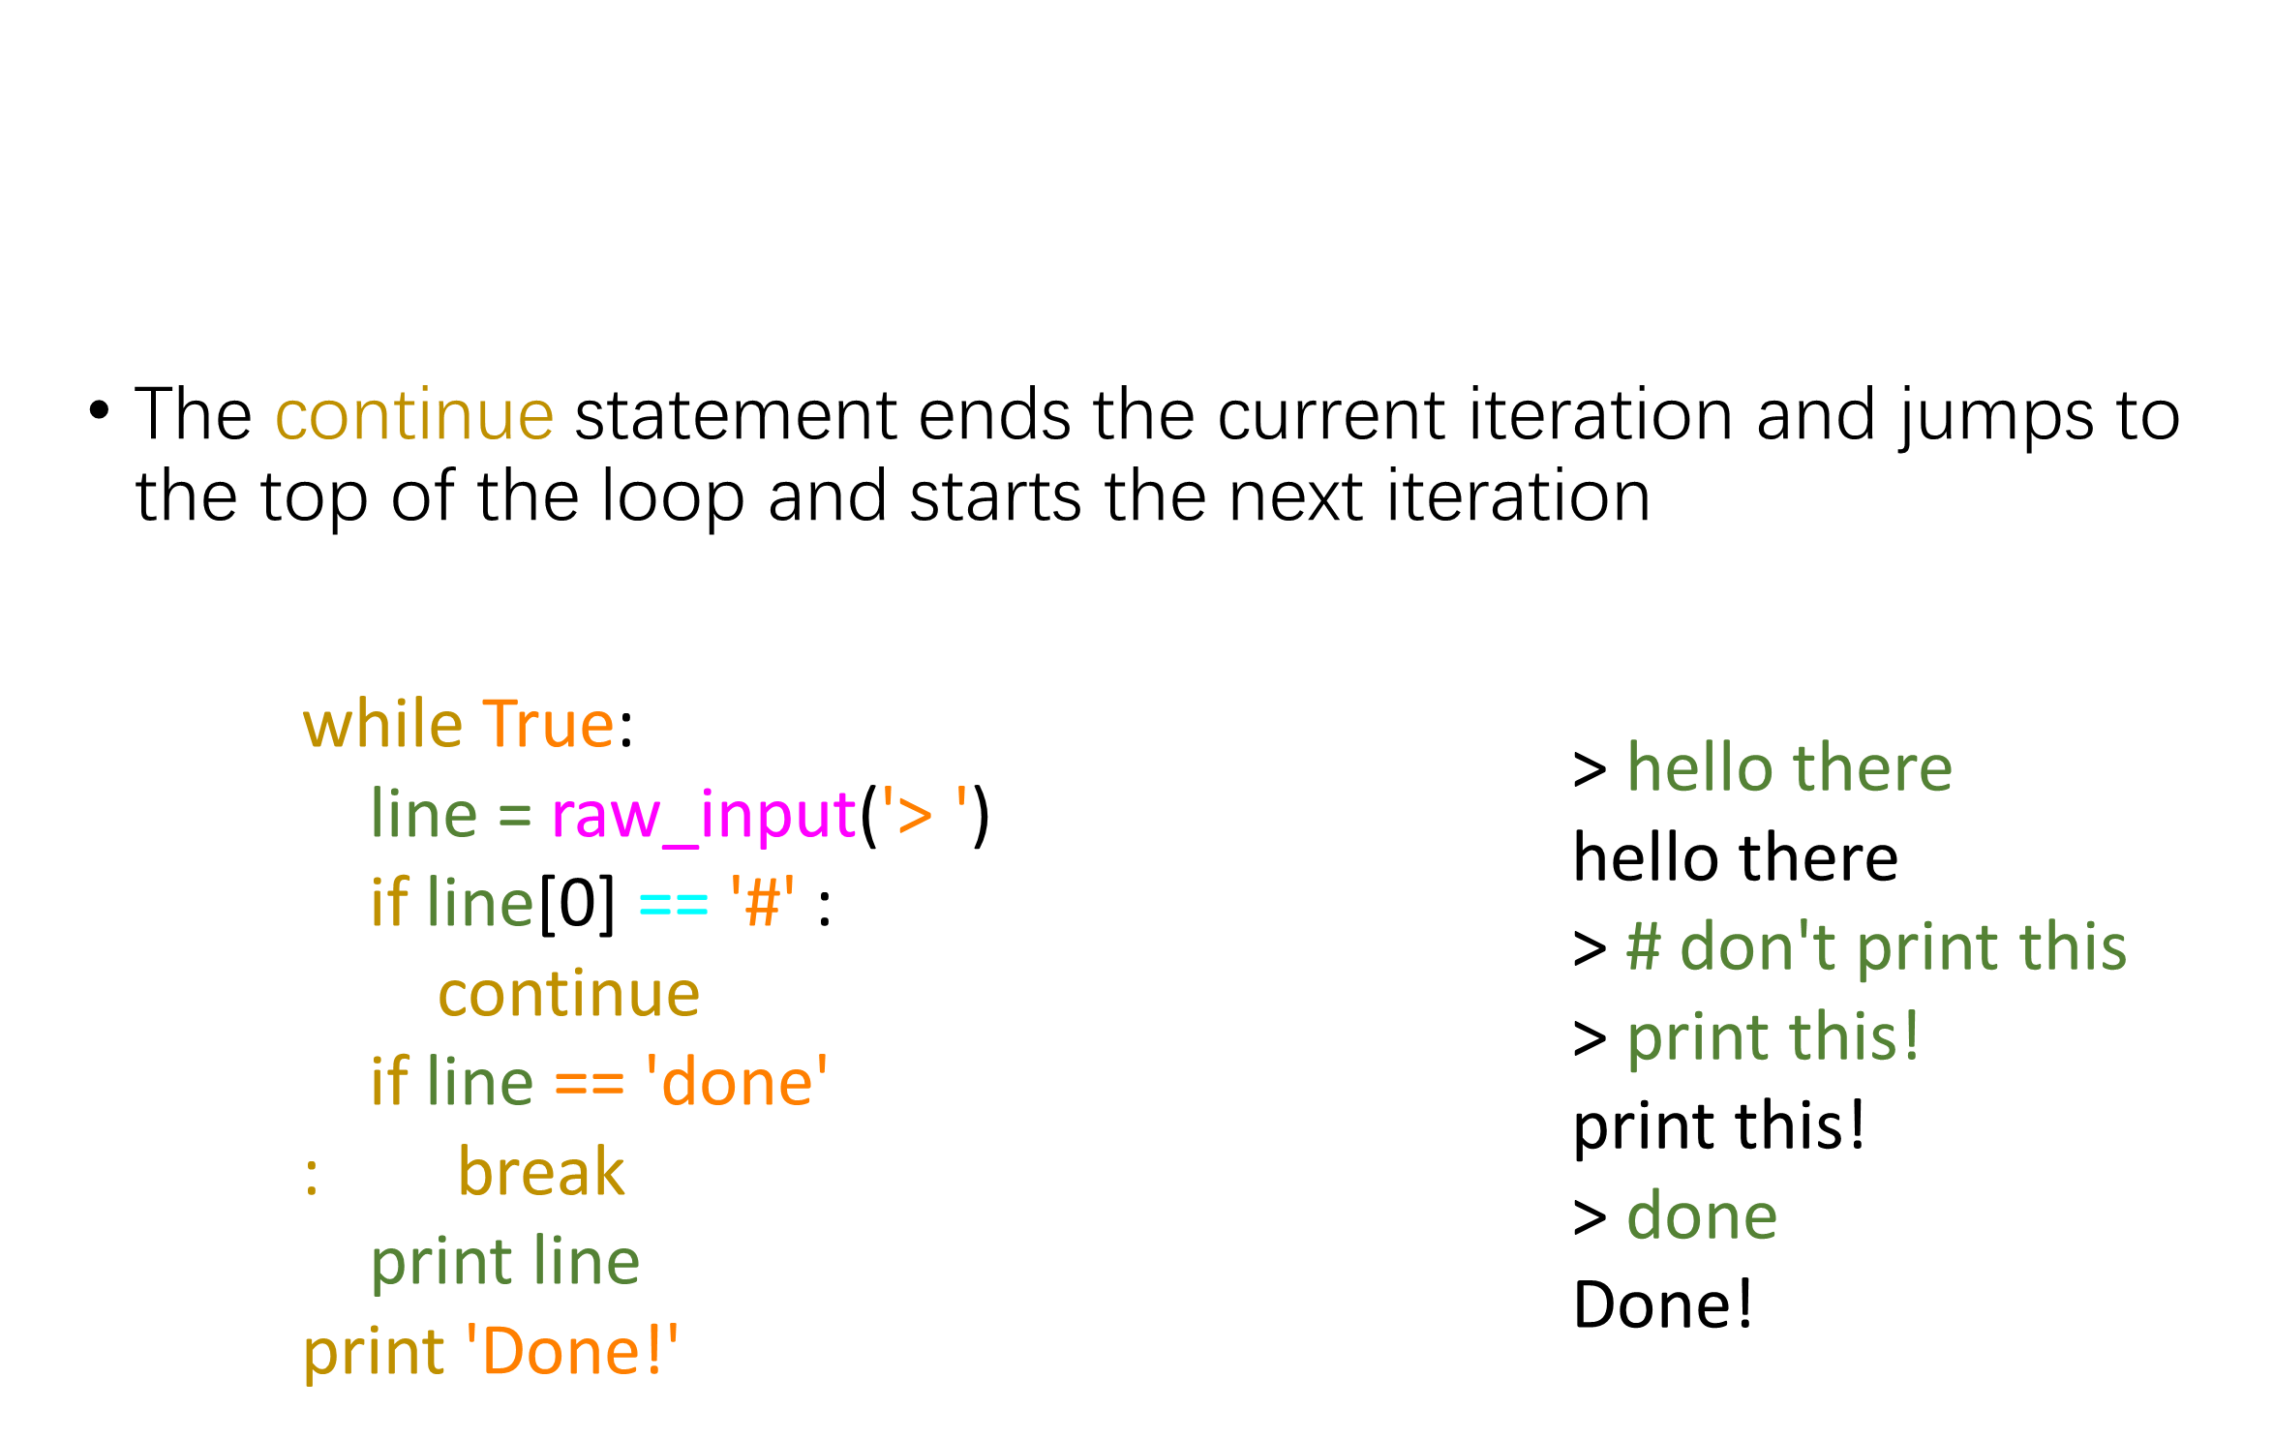
Finishing an Iteration with continue

Slide 9
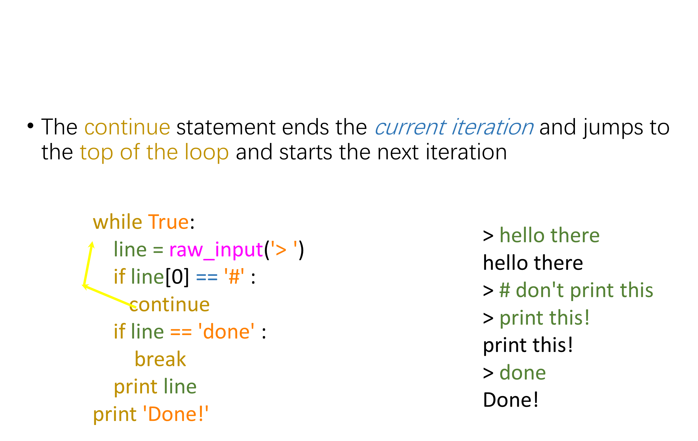
Finishing an Iteration with continue

Slide 10
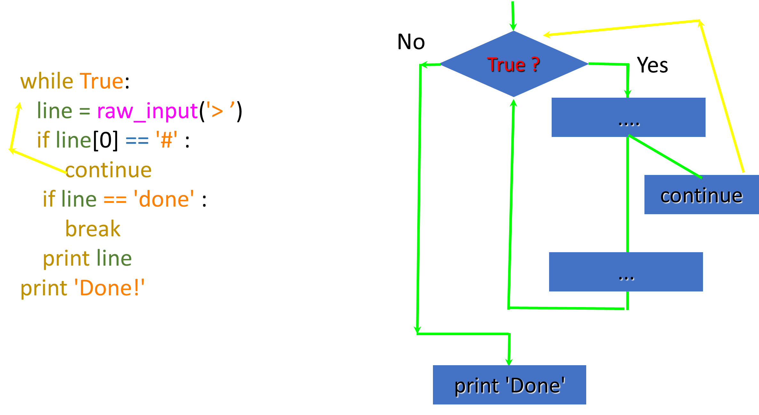

Slide 11
Indefinite Loops
While loops are called "indefinite loops" because they keep going until a logical condition becomes False
The loops we have seen so far are pretty easy to examine to see if they will terminate or if they will be "infinite loops"
Sometimes it is a little harder to be sure if a loop will terminate

Slide 12
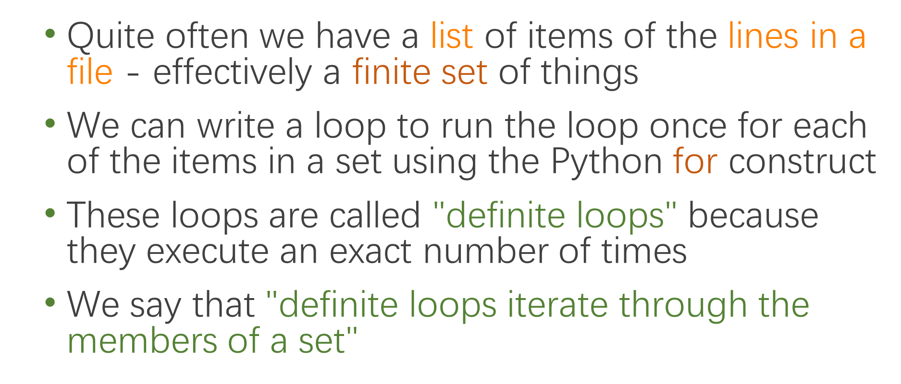
Definite Loops

Slide 13
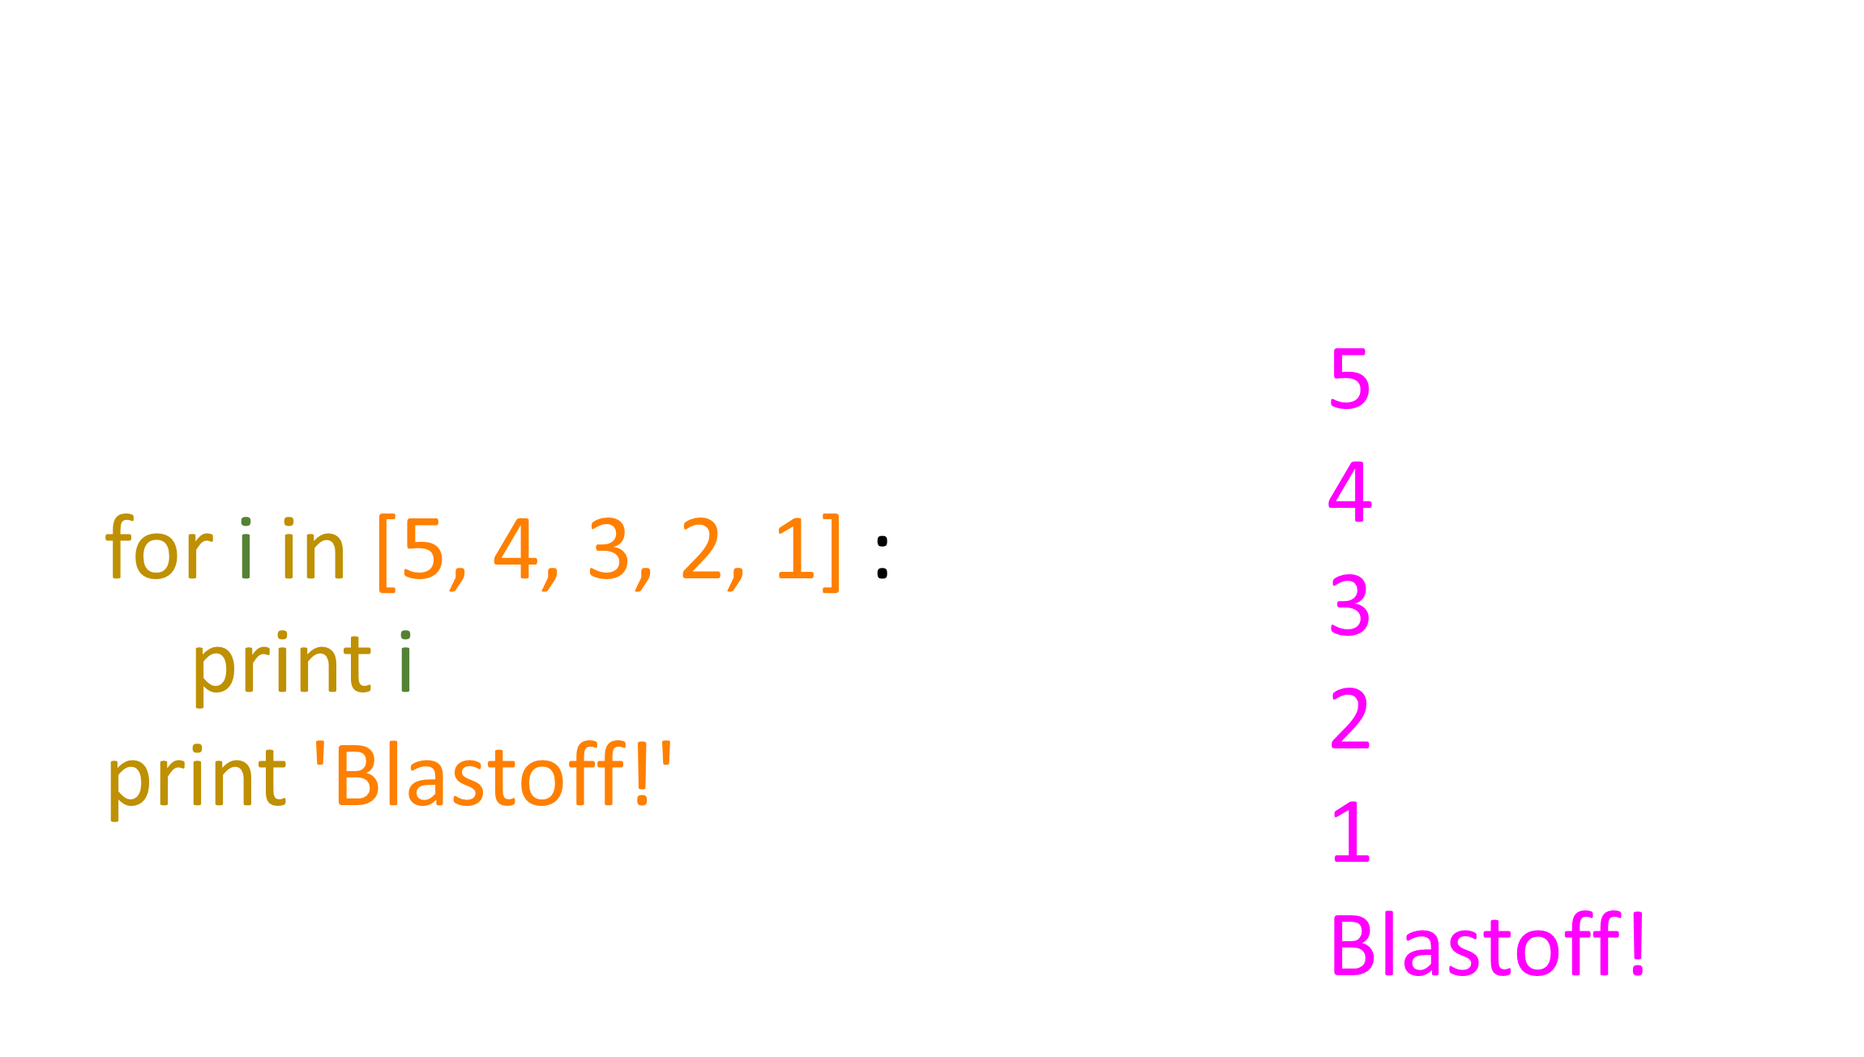
A Simple Definite Loop

Slide 14
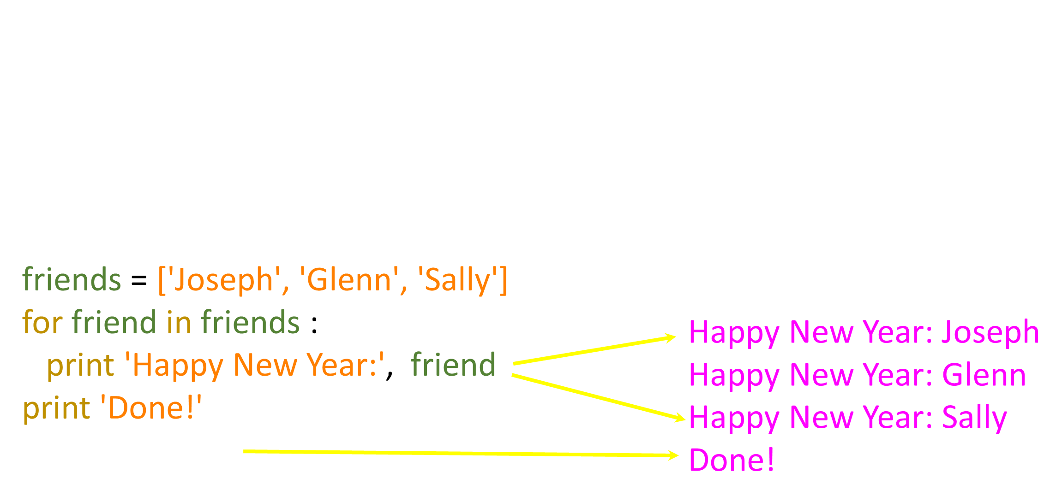
A Definite Loop with Strings

Slide 15
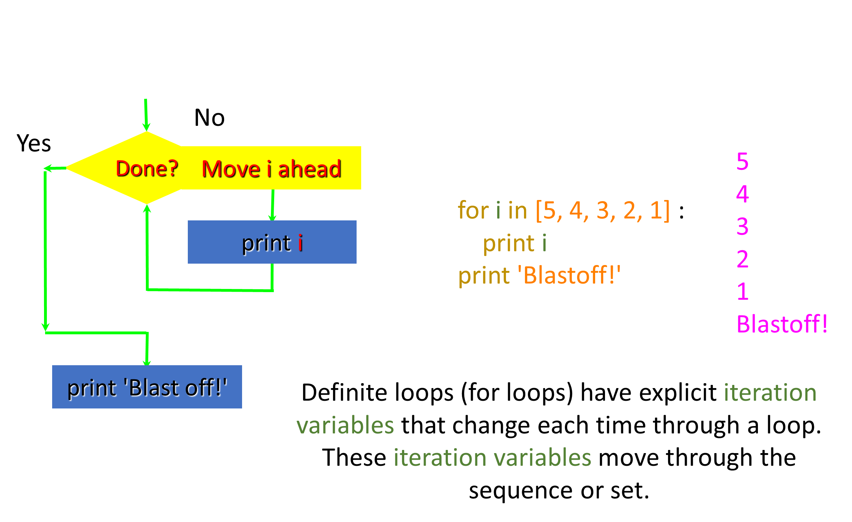
A Simple Definite Loop

Slide 16
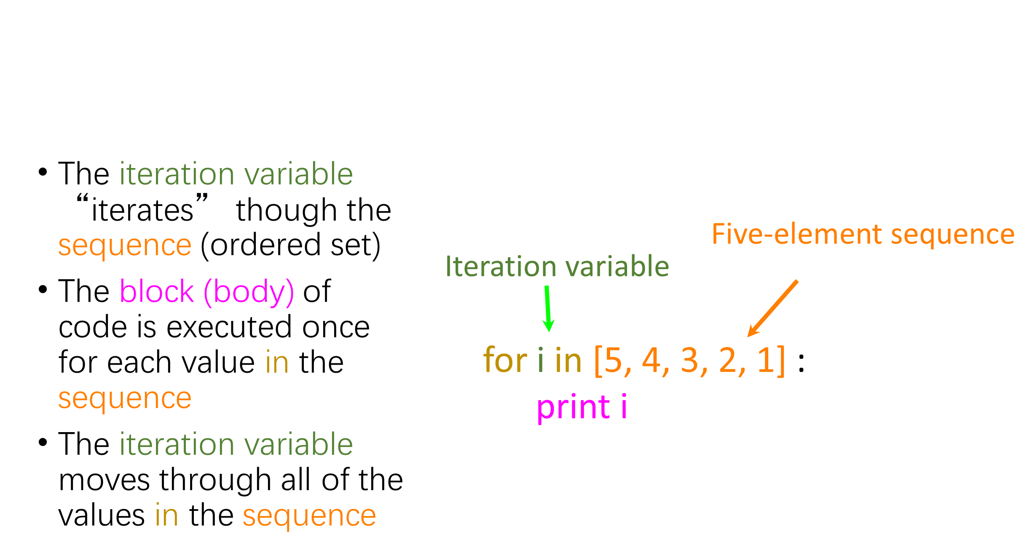
Looking at In...

Slide 17
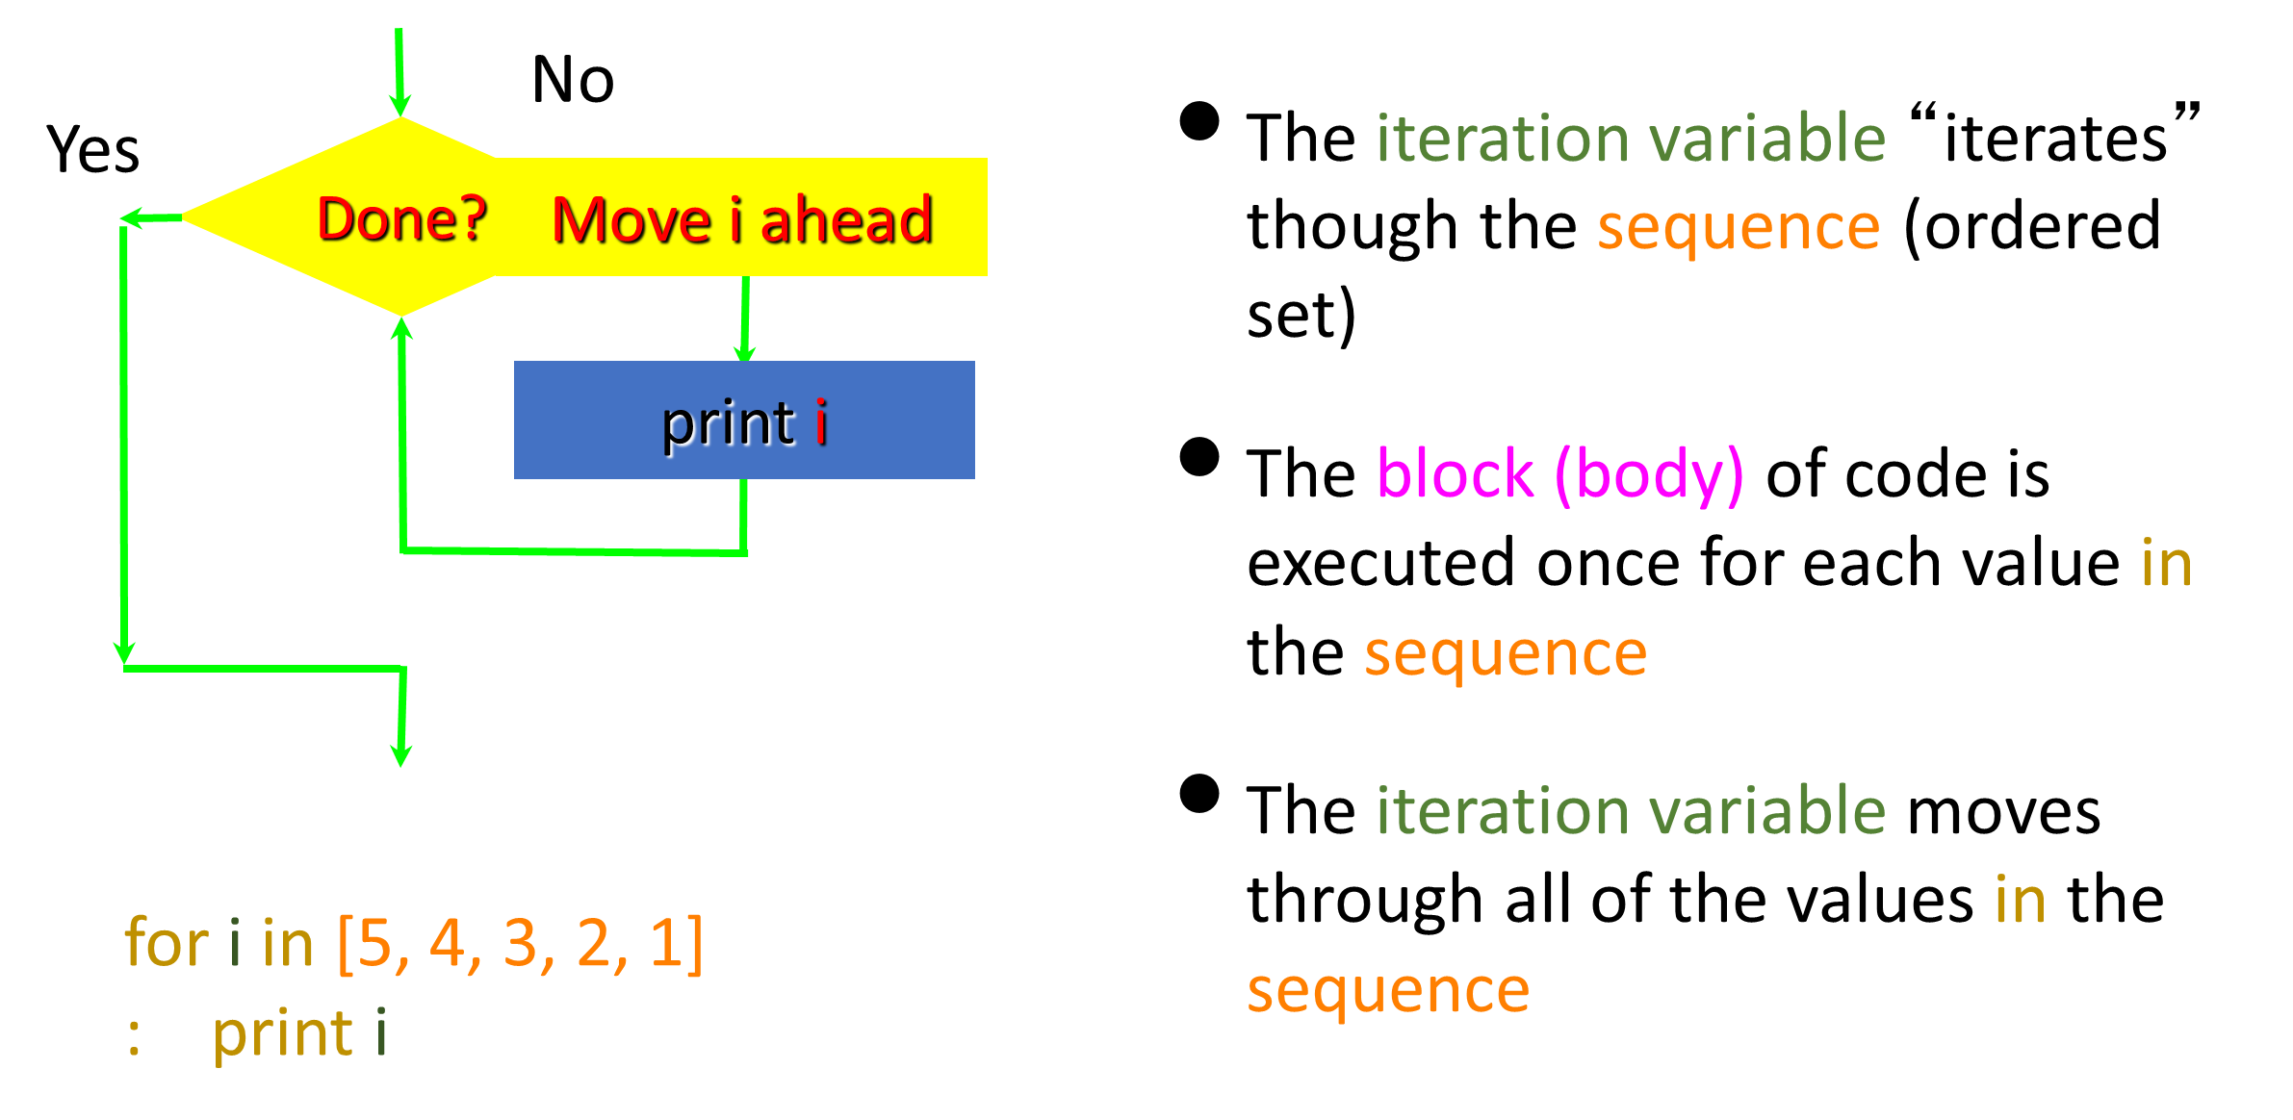

Slide 18
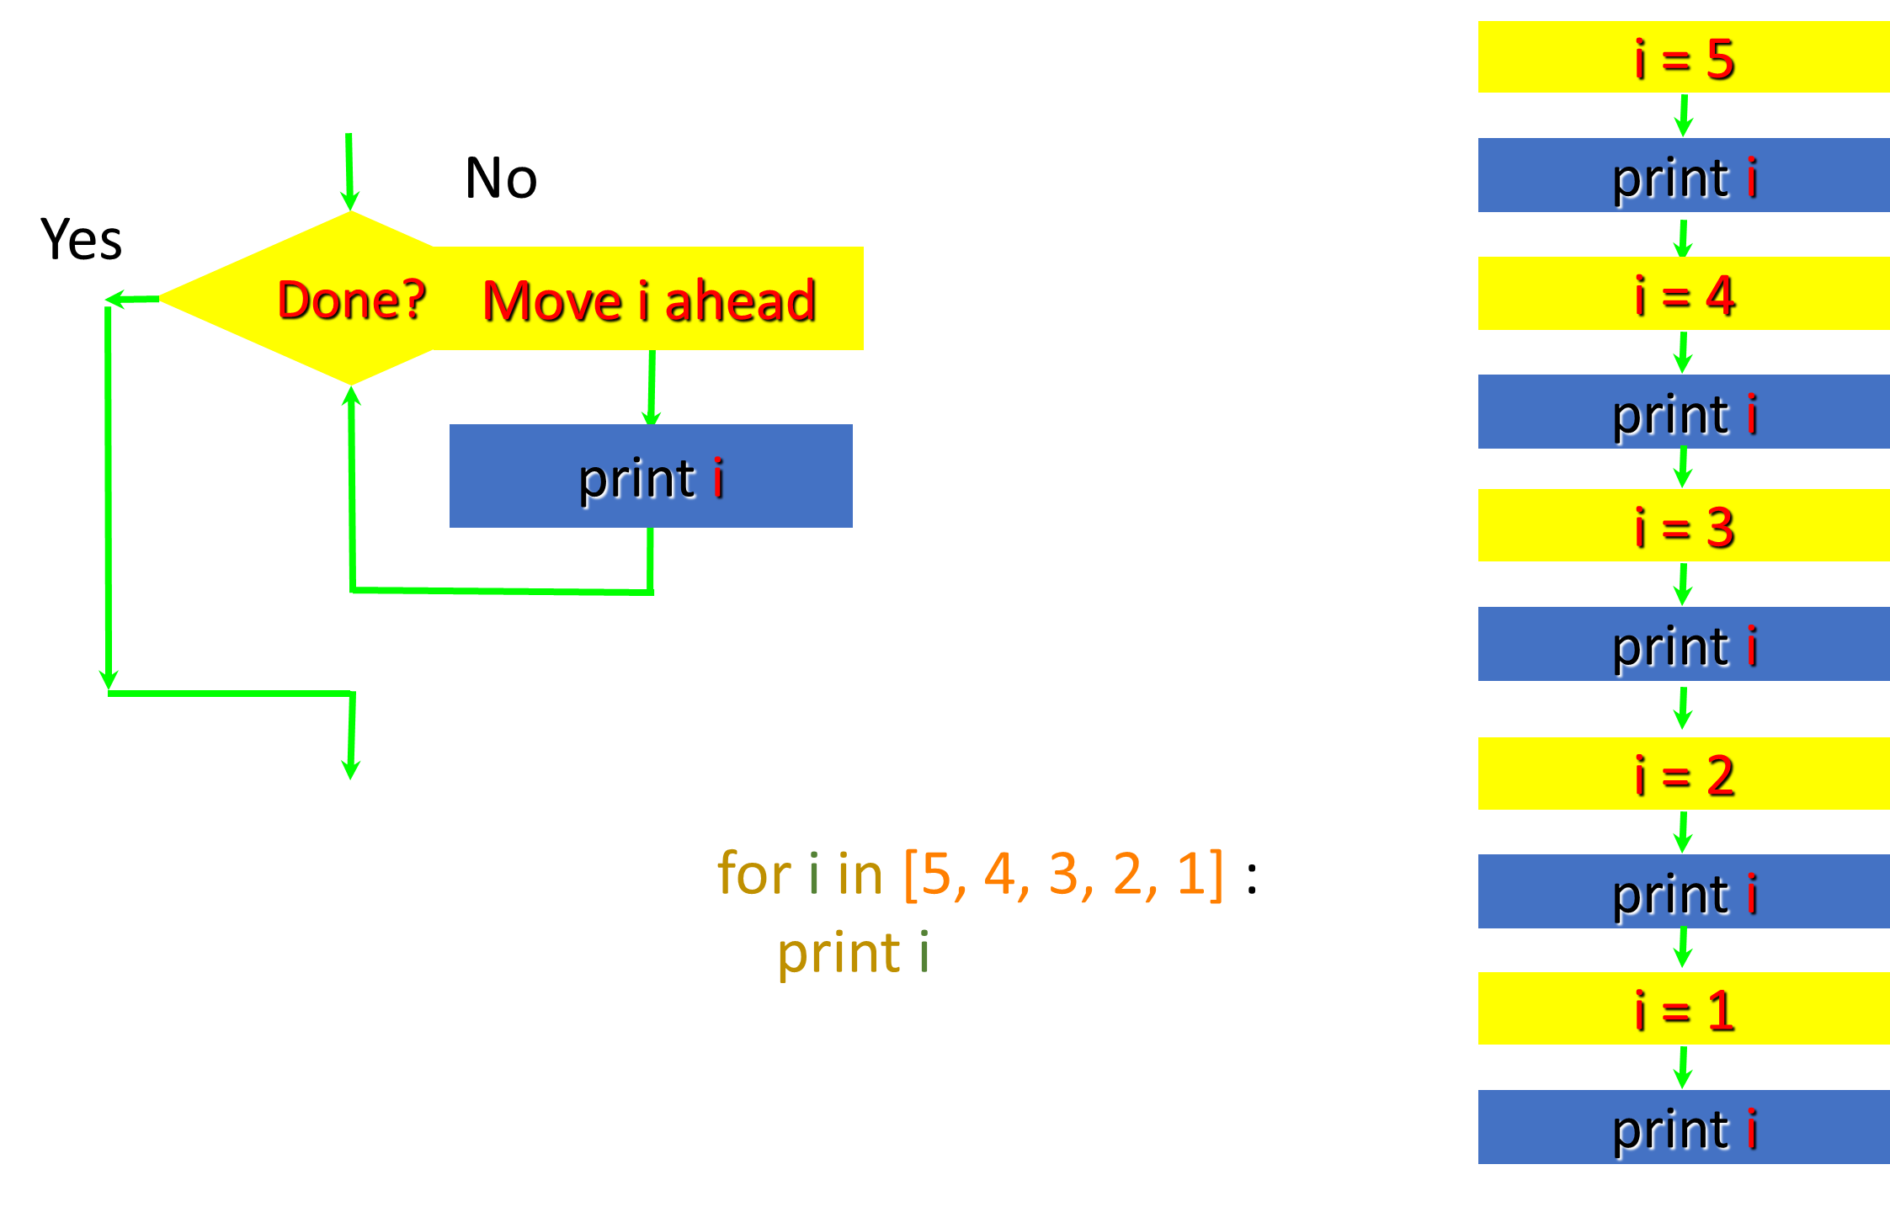

Slide 19
Definite Loops
Quite often we have a list of items of the lines in a file - effectively a finite set of things
We can write a loop to run the loop once for each of the items in a set using the Python for construct
These loops are called "definite loops" because they execute an exact number of times
We say that "definite loops iterate through the members of a set"

Slide 20
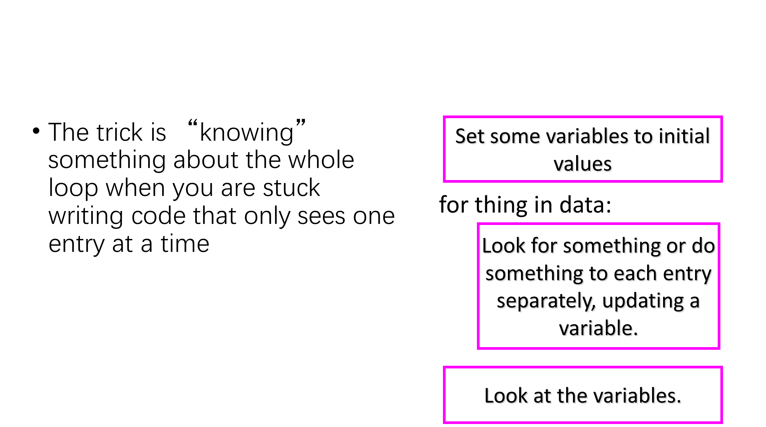
Making “smart” loops

Slide 21
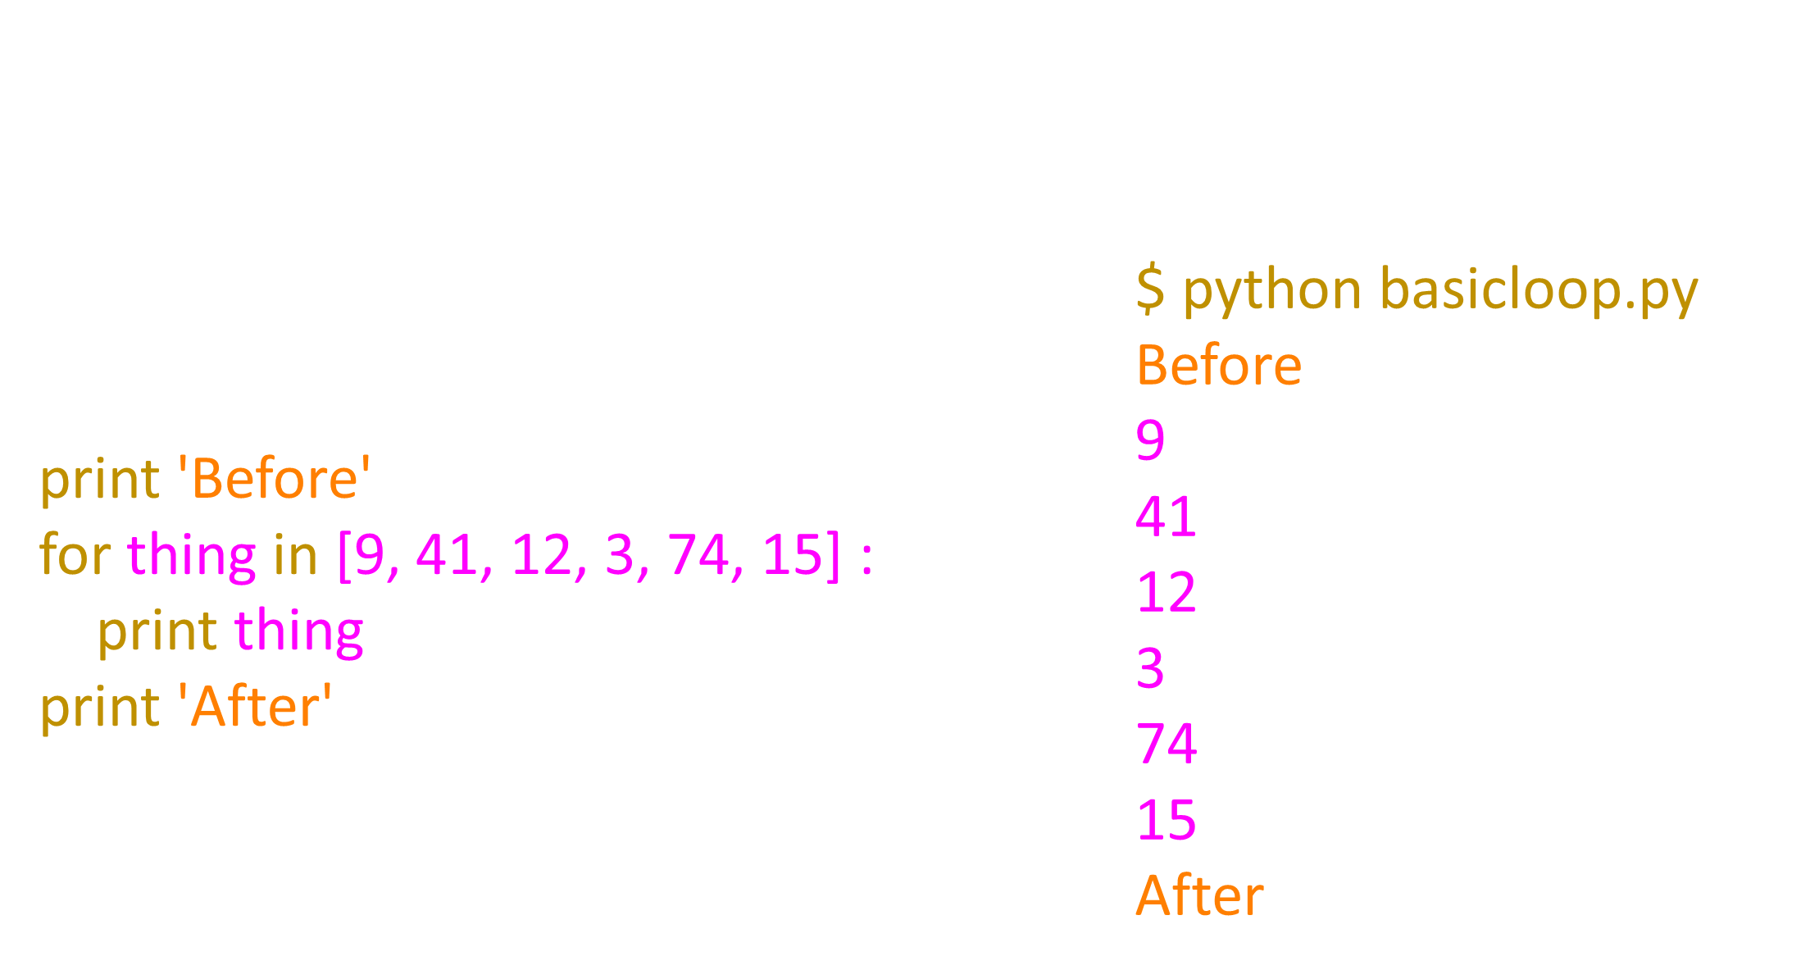
Looping through a Set

Slide 22
What is the Largest Number?

Slide 23
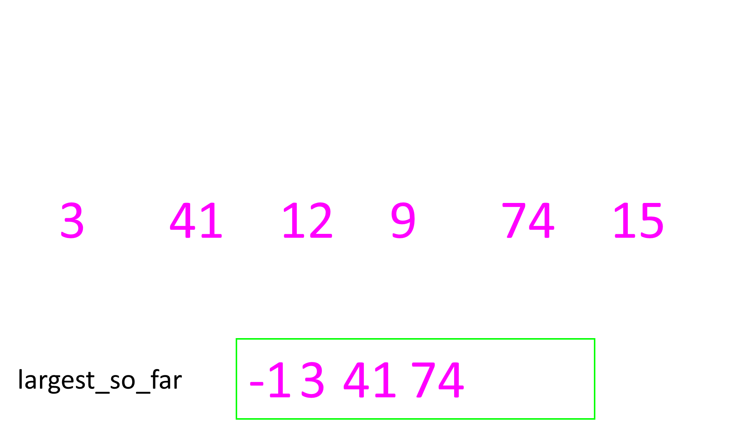
What is the Largest Number?

Slide 24
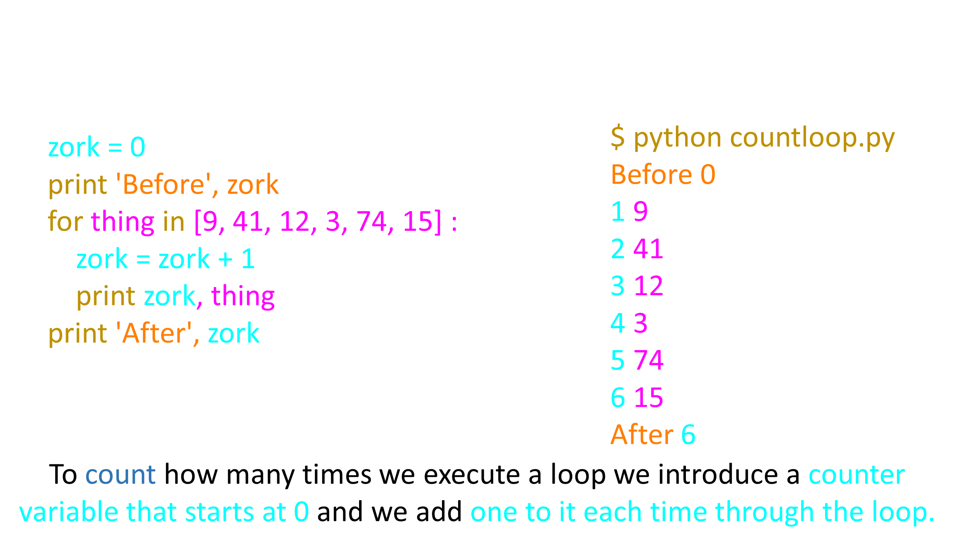
Counting in a Loop

Slide 25
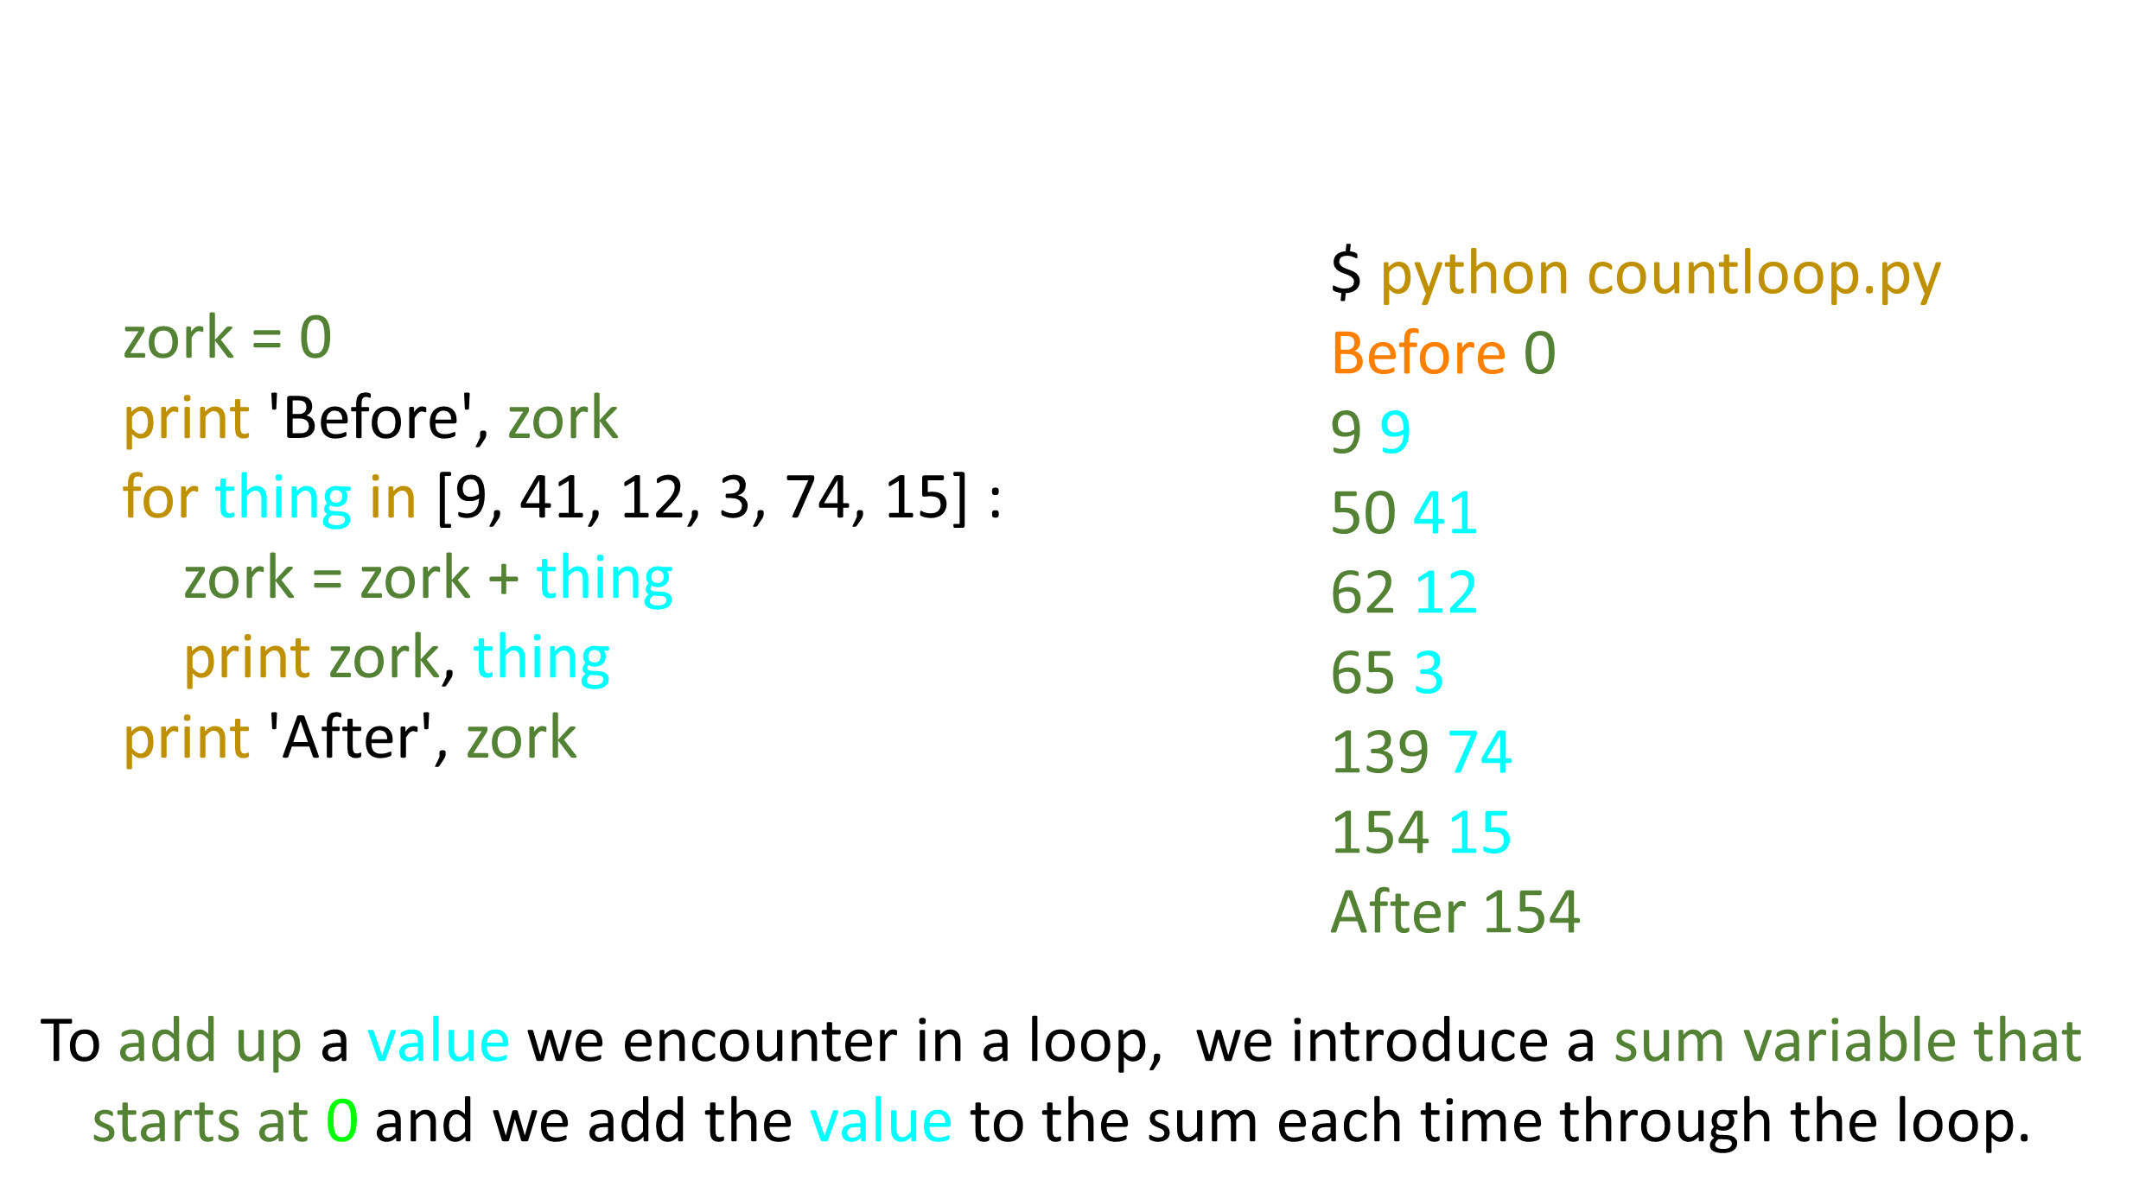
Summing in a Loop

Slide 26
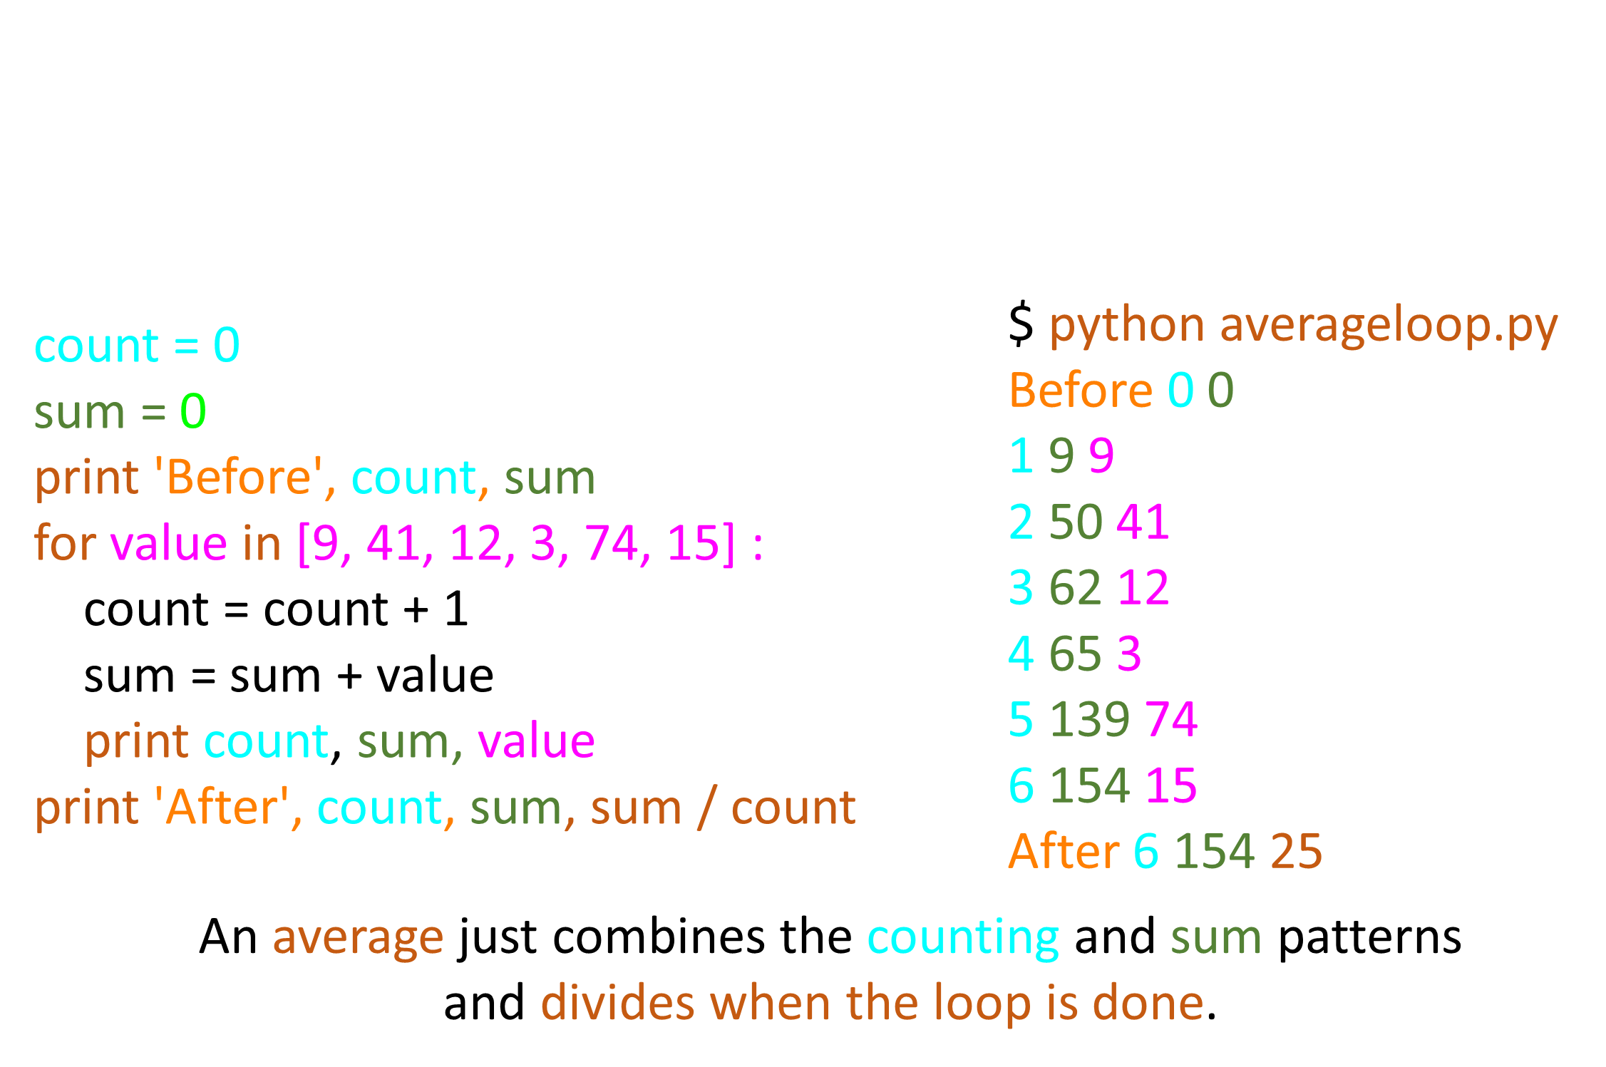
Finding the Average in a Loop

Slide 27
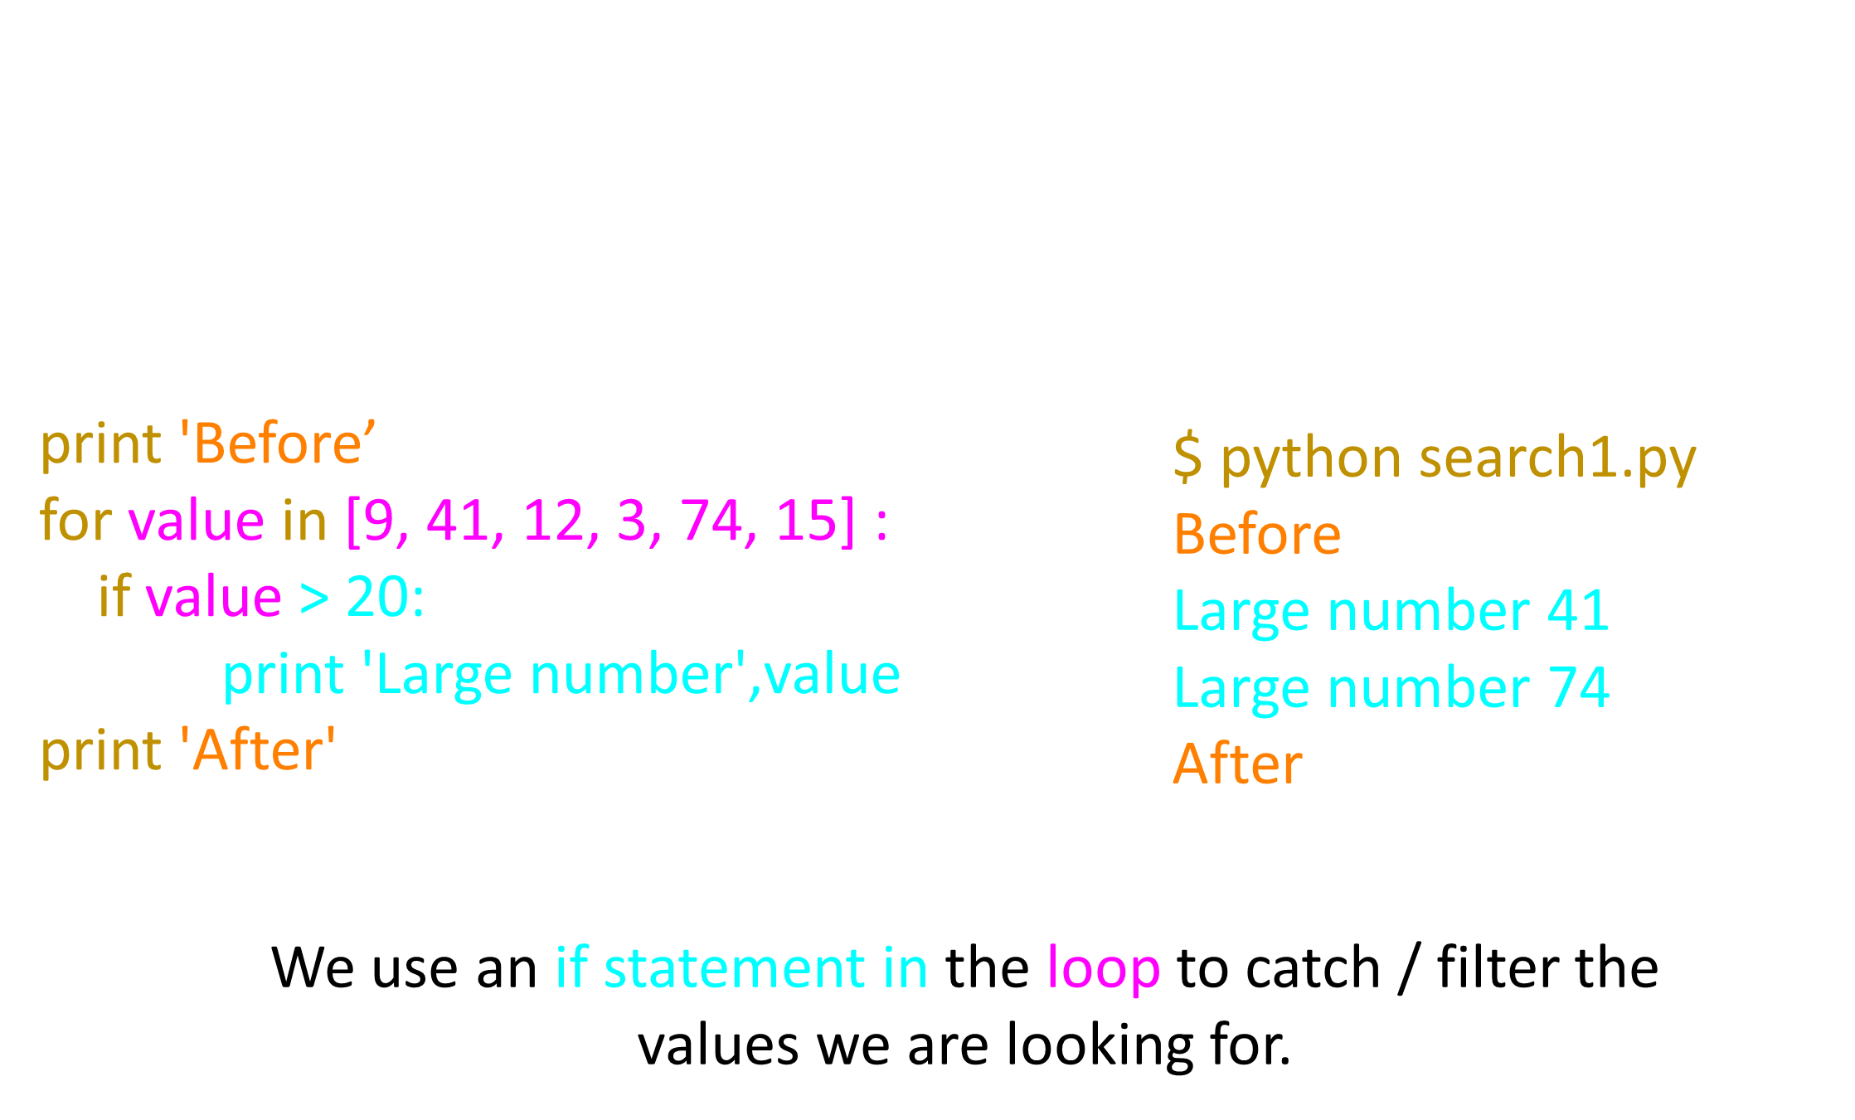
Filtering in a Loop

Slide 28
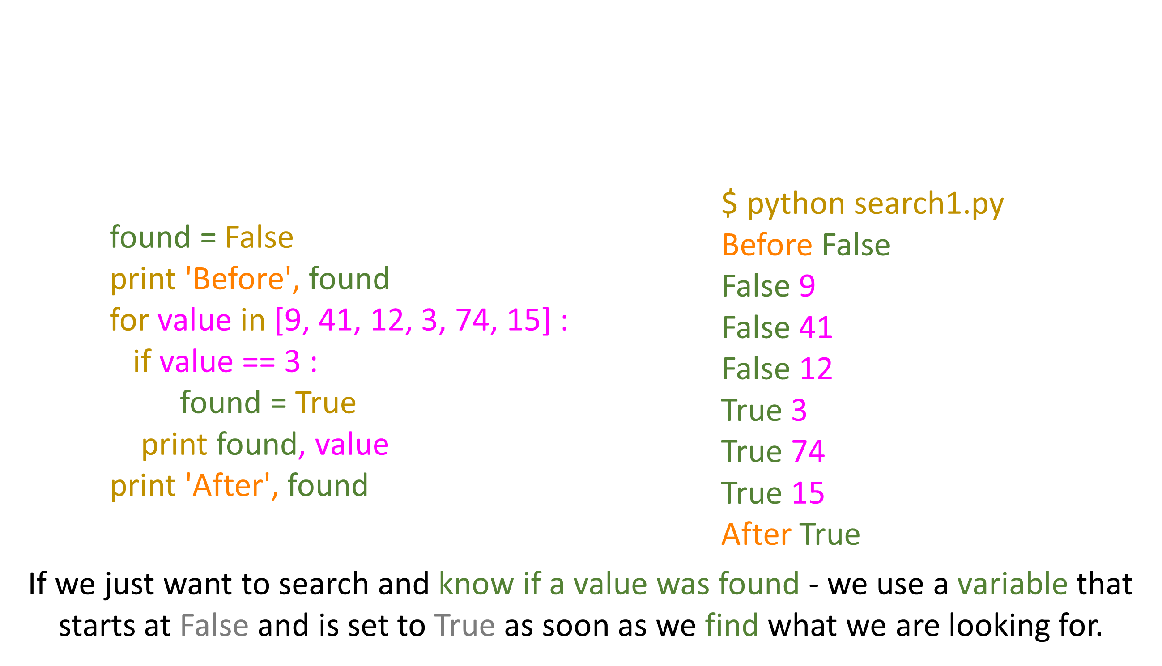
Search Using a Boolean Variable

Slide 29
What is the Smallest Number?

Slide 30
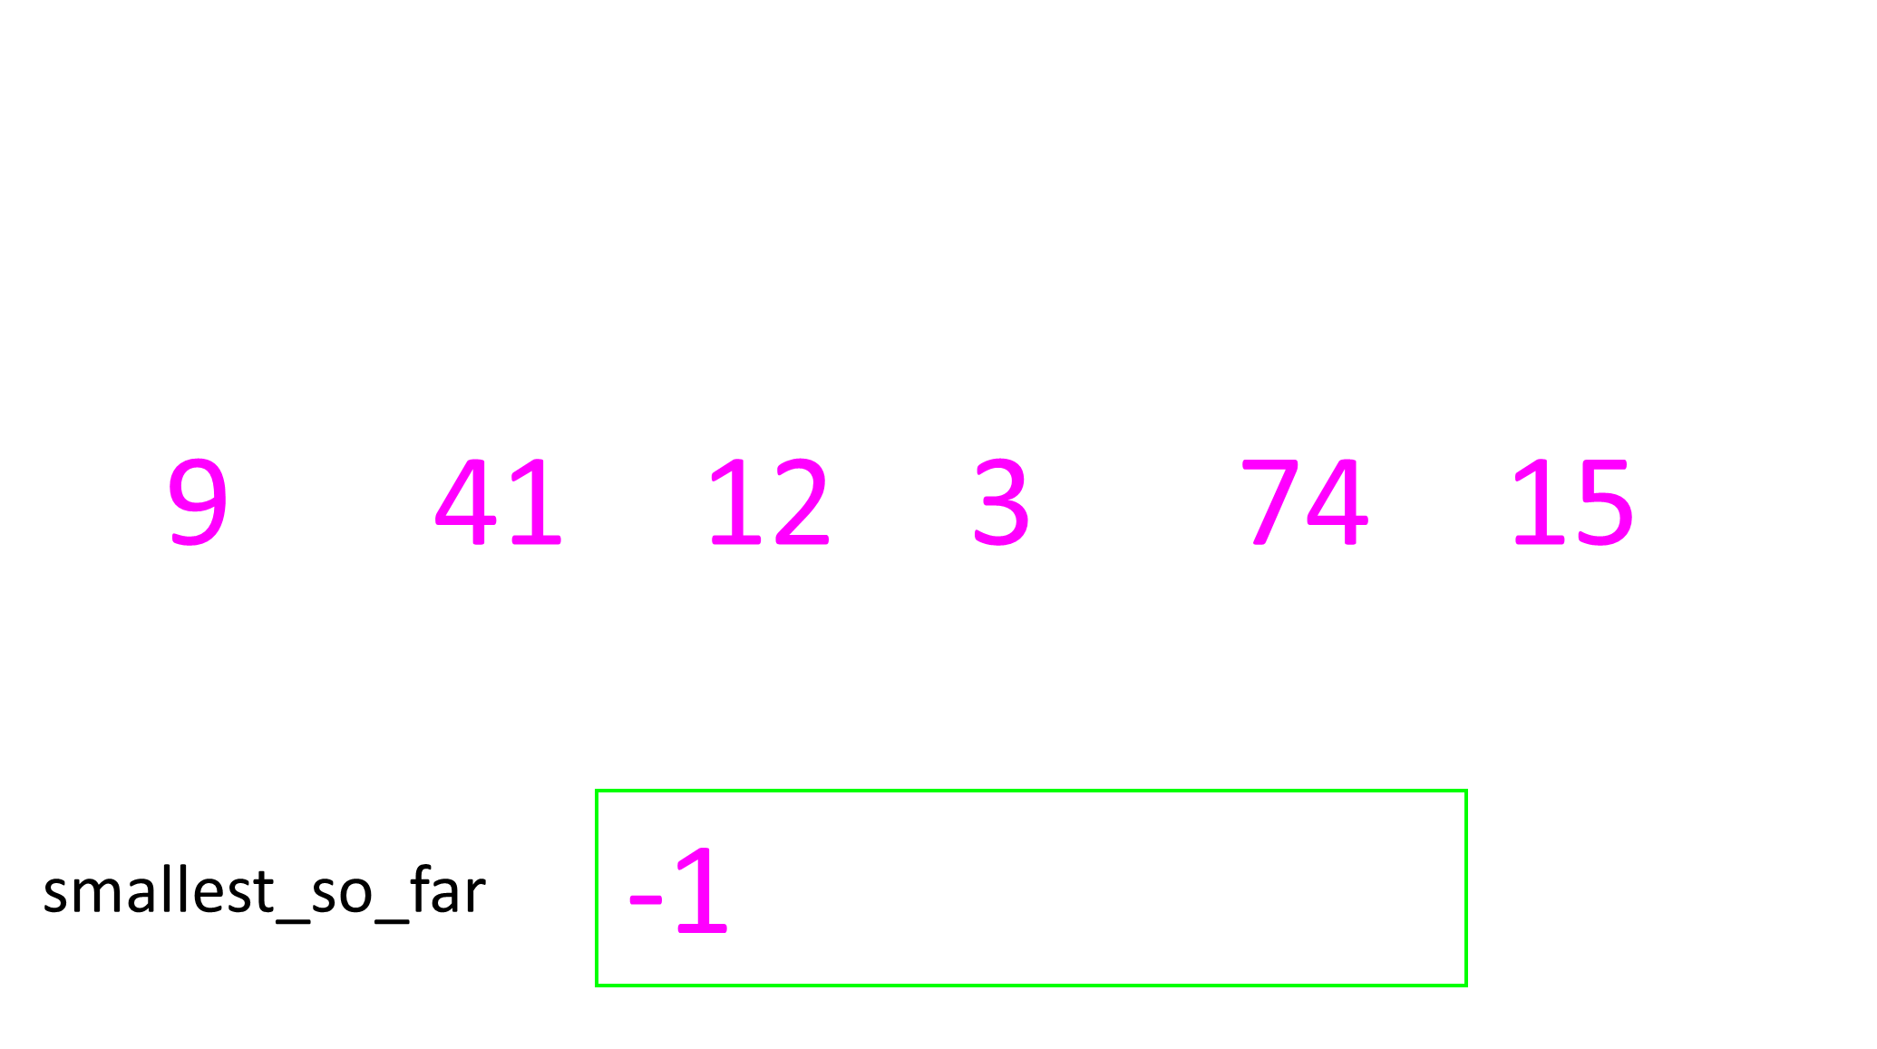
What is the Smallest Number?

Slide 31
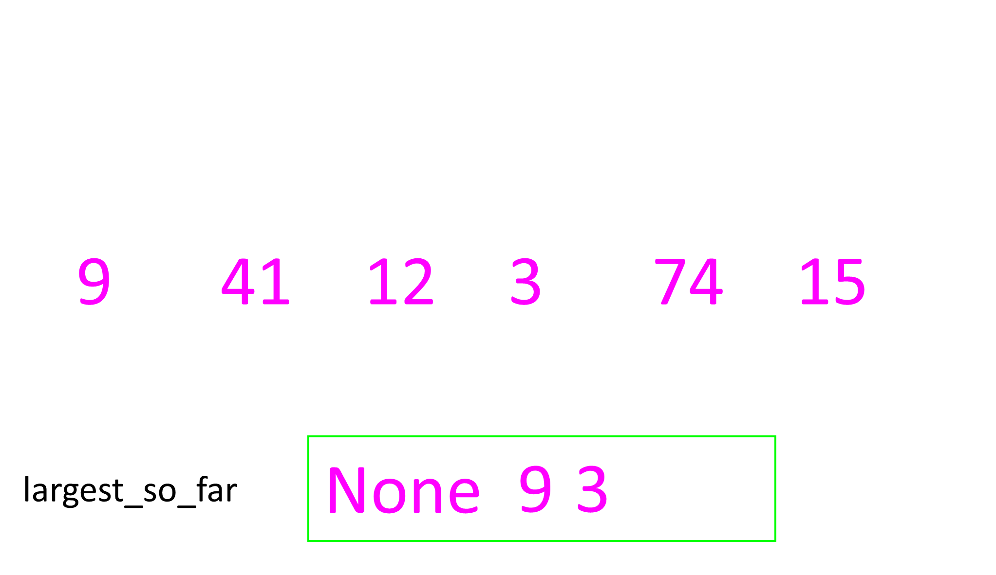
What is the Smallest Number?

Slide 32
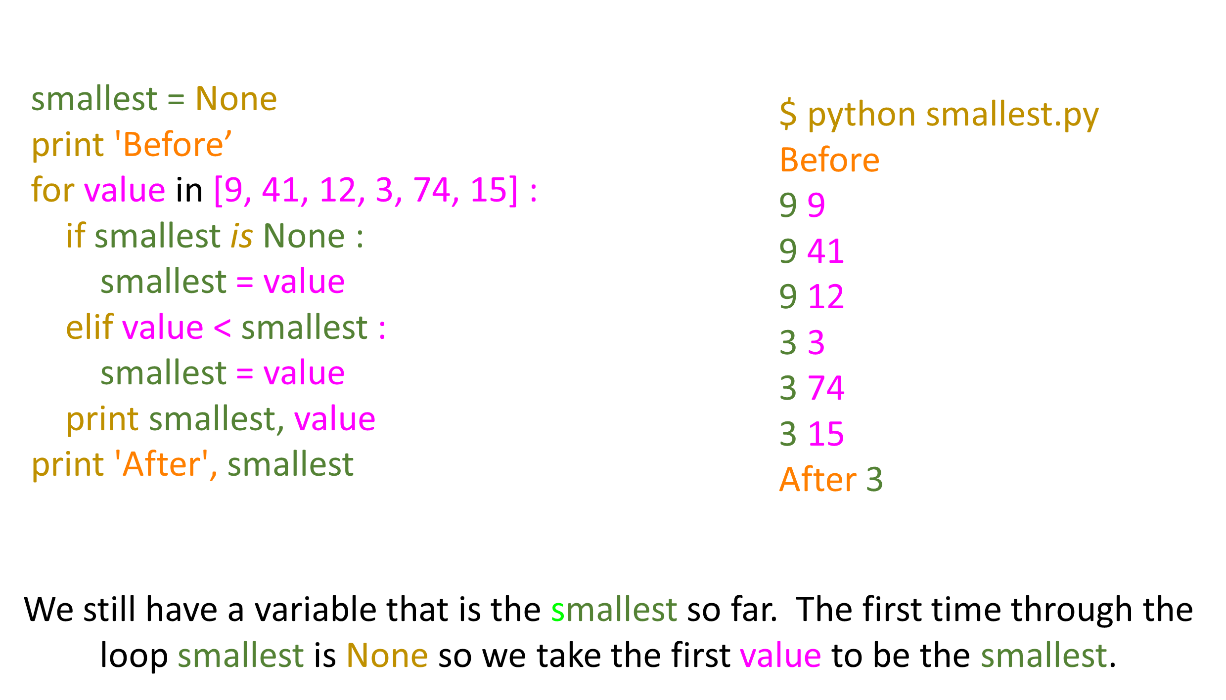

Slide 33
Summary
While loops (indefinite)
Infinite loops
Using break
Using continue
For loops (definite)
Iteration variables
Largest or smallest

Slide 34
Thank You

